Slide 1
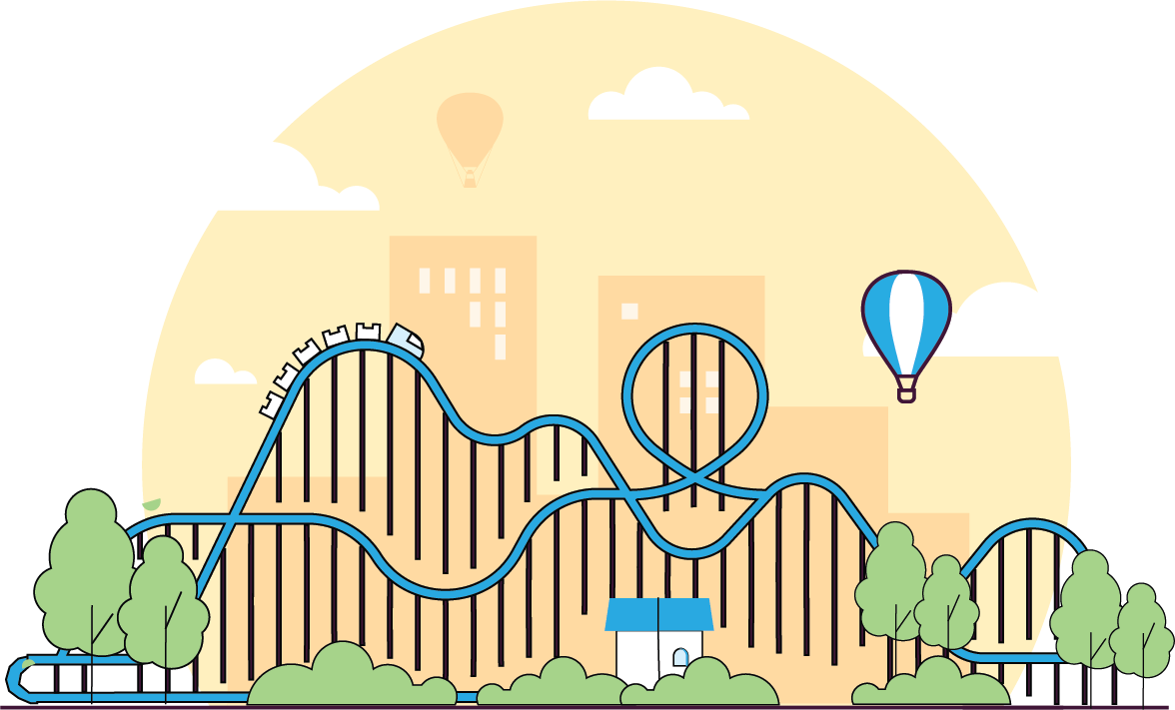


Ride Out the Ups and Downs
Don’t let market volatility derail your retirement savings plan
Retirement on the Brain
Notes:
Welcome.
Today we are taking a look at market volatility and your retirement savings.
Saving for retirement involves investing. So whether you closely follow the stock market or not, market volatility — which is what we call the natural ups and downs of the stock market — affects your retirement savings.
But even though market swings are normal, big spikes and steep drops can be stressful — especially when you’re trying to save for retirement.
There are just a few things to keep in mind during a volatile time so you can keep your savings on track.

Slide 2



Speakers
First Last Name
Title, The Standard
First Last Name
Title, The Standard
Retirement on the Brain
Notes:
[INTRODUCTIONS]

Slide 3




What is market volatility?
It’s the natural ups and downs of the financial markets.
Notes:
Since 2008, investors have seen a lot of market volatility.
Major events like the global economic slowdown or foreclosure crisis can contribute to swings in the market.
Everyday activity can also cause stock prices to shoot up. On the flip side, news stories, weak earnings reports and world events can trigger downward trends.
Volatility is to be expected, but that doesn’t stop investors from worrying about the health of their investments.

Slide 4


How do you stomach the bumps and keep on saving? (1/4)
Follow 3 key strategies.
Notes:
Remember — there’s still no better way to improve your retirement readiness than to participate in your employer-sponsored plan. Preparing now will make sure you’ll be able to maintain your current lifestyle after you stop working.
Let’s look at three key strategies to help you ride out the ups and downs of the market.

Slide 5

How do you stomach the bumps and keep on saving? (2/4)
Follow 3 key strategies.
Stick to Your
Investment Plan
Make sure your plan includes:
A retirement date. Figure out how much time you’ll have to save.
Your major life goals. Plan for small and big events in the future.
Your tolerance for risk. Find
your comfort zone.
Notes:
The first key strategy is to create an investment plan. Sticking to it — even when the markets are going wild — is just as important.
A strong plan will factor in three things:
Your projected retirement date
Your major life goals
Your tolerance for risk
For example, if you plan to retire in the next five years, you probably want to select more conservative options that are less risky.
If you have 15 years to save, you might take on more risk and invest in options with higher growth potential.
When the market gets volatile and your emotions kick in, refer to your investment plan to stay on course.

Slide 6

How do you stomach the bumps and keep on saving? (3/4)
Follow 3 key strategies.
Stick to Your
Investment Plan
Make sure your plan includes:
A retirement date. Figure out how much time you’ll have to save.
Your major life goals. Plan for small and big events in the future.
Your tolerance for risk. Find
your comfort zone.
Diversify Your Investments
Reduce your financial risk by putting your money into different types of investments.
Notes:
The second key strategy is to diversify your investments. That just means to put your money into different kinds of investments that don’t react in the same way to market swings.
Bonds, for example, may rise in value when stocks are not performing well.
While diversification does not guarantee a profit or protect against a loss in a declining market, it can help reduce your exposure to risk.
A well-diversified portfolio may include stocks, bonds and cash equivalents, as well as alternative investment types such as real estate investment trusts, commodities and international or emerging market stocks.
The latter investments may be considered higher risk than the former, but can actually reduce risk during times of economic uncertainty.

Slide 7

How do you stomach the bumps and keep on saving? (4/4)
Follow 3 key strategies.
Stick to Your
Investment Plan
Make sure your plan includes:
A retirement date. Figure out
how long you'll have to save.
Your major life goals. Plan for
small and big events in the future.
Your tolerance for risk.
Find your comfort zone.
Diversify Your Investments
Reduce your financial risk by putting your money into different types of investments.
Think Long Term
Good news! The stock market has experienced overall growth for at least the past 80 years. Average returns have been about 10% a year.*
* Past performance is no guarantee of future results. The investment return and principal value of an investment will fluctuate and an investor’s interest, when redeemed, may be worth more or less than the original investment.
Source: “Annual Returns on Stock, Bonds and T.Bills: 1928–Current,” NYU Stern School of Business, 2019.
Notes:
The last key strategy is to think long term.
Because the good news is that even with volatility, the stock market has experienced:
Overall upward growth for more than 30 years
Average returns of approximately 10% a year
When saving for retirement, the longer you’re invested, the better off you’re probably going to be.
Long-term investing gives more time for potential growth and may absorb the ups and downs of the markets. Taking the long-term view means maintaining or even increasing your savings during uncertain times.

Slide 8
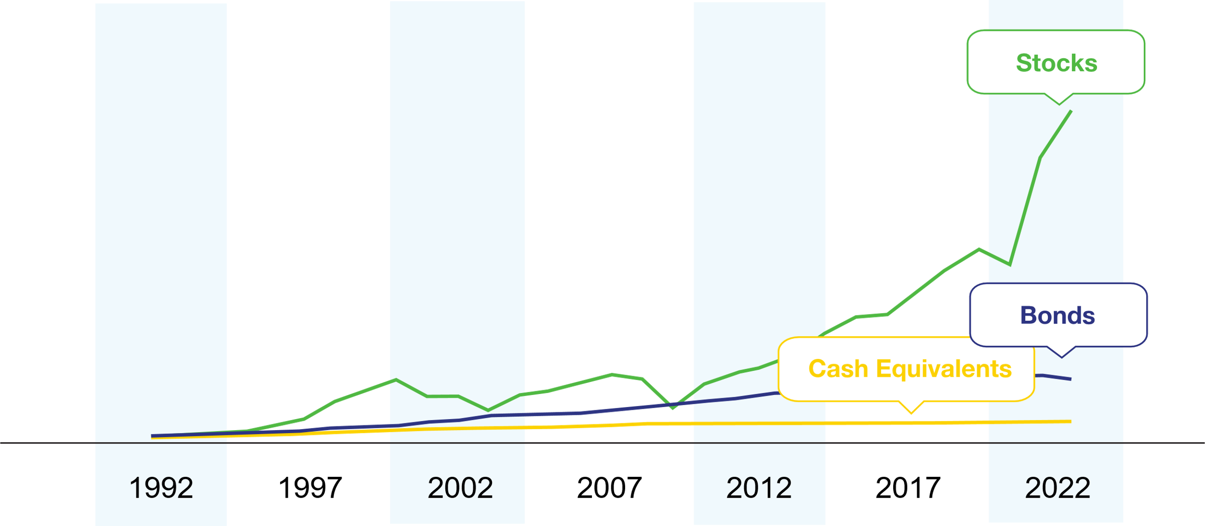

Chart
The index performance shown is for illustrative purposes only and is not indicative of the performance of any specific investment. This illustration assumes $1,000 invested in each category from September 30, 1992 – September 30, 2022. The illustration is based on the S&P 500 Index, the BarCap U.S. Aggregate Bond Index, the 3-Month T-Bill Index and the Consumer Price Index. You cannot directly invest into an index. It does not represent the performance of any actual accounts and is not a forecast or promise of future returns. The returns presented assume a constant allocation to each index, and do not consider the fluctuations in value that can impact the overall allocation between rebalancing. In addition, the portfolio allocation does not change regardless of economic or market conditions. As a result, the returns on actual portfolios may be different. Past performance is no guarantee of future results. Investments are subject to market risk and fluctuate in value. Source: Morningstar Direct.
Notes:
Here’s a look at how markets have stayed on an upward trajectory since 1989.
As you can see, while stocks have been more volatile, they've historically surpassed the growth of other investment options over time.

Slide 9







Buckle Up and Remember This
Buckle Up and Remember This
Avoid trying to time the market.
Avoid the urge to reduce or stop contributions to your retirement plan.
Avoid keeping all or most of your assets fixed-income investments, such as cash equivalents and bonds, unless
you’re near or at retirement age.
Avoid selling stock investments when the market goes down.
Notes:
To stay on track for retirement readiness, there are a few actions you want to avoid.
Don’t sell stock investments when the market goes down. You can often protect your savings if you wait for the market to rebound.
Don’t try to time the market. It's difficult for anyone to consistently time the market. Most investors benefit from taking a long-term approach to growth.
Don’t reduce or stop adding to your retirement plan. Steadily adding to your savings, together with long-term growth, allows you to increase your savings.
Don’t keep all or most of your assets in fixed-income investments, such as cash equivalents and bonds, unless you are near or at retirement age.

Slide 10

Rebalance and Reset
Rebalance your investments on a regular basis – quarterly, semiannually or once a year.
After a volatile period in the market, rebalancing resets your portfolio to your desired investment mix.
Notes:
Another smart thing to do on a regular basis is to rebalance your investment plan.
Do this quarterly, semiannually or once a year.
Volatile markets can change your proportion of funds in different asset classes, such as bonds, large growth stocks or international stocks. Rebalancing moves your portfolio back to your desired investment mix to match your risk and investment goals.
It’s also a good idea to review your investment plan each year. Be flexible and willing to change your investment strategy if your retirement goals change.

Slide 11

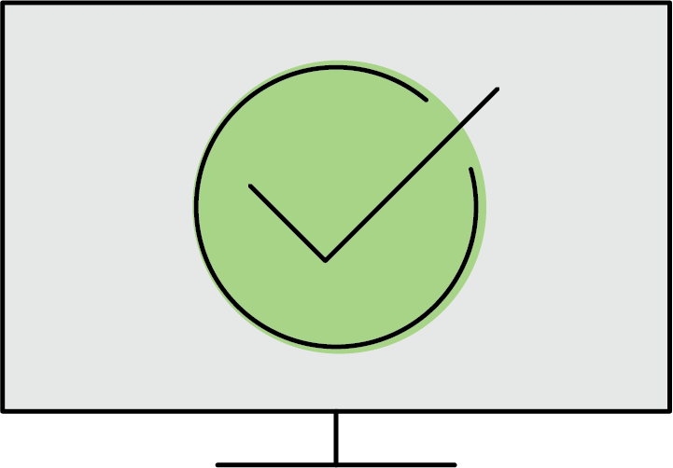

Need Help Planning?
Go to our Retirement Needs Calculator to see how much you’ll need and how much to save.
Take our investor profile quiz for help choosing investments with lower or higher levels of risk.

Slide 12


Questions?
When you’re ready, enroll in your plan or increase your contribution.
Go to standard.com/retirement.

Slide 13
Conclusion
The Standard is the marketing name for StanCorp Financial Group, Inc., and its subsidiaries. StanCorp Equities, Inc., member FINRA, wholesales a group annuity contract issued by Standard Insurance Company and a mutual fund trust platform for retirement plans. Standard Retirement Services, Inc. provides financial recordkeeping and plan administrative services. Investment advisory services are provided by StanCorp Investment Advisers, Inc., a registered investment advisor. StanCorp Equities, Inc., Standard Insurance Company, Standard Retirement Services, Inc., and StanCorp Investment Advisers, Inc., are subsidiaries of StanCorp Financial Group, Inc., and all are Oregon corporations.
Employers and plan participants should carefully consider the investment objectives, risks, charges and expenses of the investment options offered under the retirement plan before investing. The prospectuses for the individual mutual funds in the group annuity contain this and other important information. Prospectuses may be obtained by calling 877.805.1127. Please read the prospectus carefully before investing. Investments are subject to market risk and fluctuate in value.
RP 21301
(7/22)

