Slide 1




Invierta a su gusto
Elija las opciones que se adapten bien a su apetito de riesgo
Con el pensamiento de jubilarse
Notes:
Your employer offers a retirement plan to help you prepare for the future.
Whether you’re already enrolled or still thinking about signing up, we understand that the idea of picking investments can be overwhelming.
Today we’re going to help you with that. We’ll be discussing:
Your appetite for risk when it comes to investing for retirement
The three types of investment choices
Managing risk through diversification

Slide 2


Conferencistas
Nombre y apellido
Puesto, The Standard
Nombre y apellido
Puesto, The Standard
Con el pensamiento de jubilarse
Notes:
[INTRODUCTIONS]

Slide 3
Motivos de ahorro para la jubilación
Dinero para compras esenciales
Dinero para la recreación
Dinero para
adquisiciones mayores
Con el pensamiento de jubilarse
Notes:
First, let’s talk about why saving for retirement is important.
You’re working now. But when you retire and stop getting a regular paycheck, you’ll still have to cover many of the same expenses you have now. And possibly some new ones, too.
Here’s what you’ll probably need:
Money to live on
Rent or mortgage
Food and necessities
Utilities and other expenses
Insurance
Transportation
Medical expenses
Money for fun
Travel expenses
Club memberships
Hobbies and activities
Money for major purchases
Car
Home projects
Real estate
Technology, like new phones and computers
Think about how you will cover these expenses?

Slide 4

Su plan de jubilación le da la libertad de elegir sus inversiones
Con el pensamiento de jubilarse
Notes:
Investing money in your retirement plan now can help you grow the savings you’ll need to live on in retirement.
The sooner you start saving, the easier it can be. Starting early gives your money time to compound. That’s when the earnings on your savings are reinvested and begin earning an investment return of their own.
Another great thing about your retirement plan is that you can choose how your money is invested. And choosing investments doesn’t have to be complicated.

Slide 5


¿A qué se refiere el riesgo? El riesgo se refiere a la posibilidad de perder dinero. Mientras invierte para su jubilación, es una buena idea que revise su apetito de riesgo.
Notes:
Investing always comes with some risk. Risk refers to the chance that you could lose money.
As you invest for retirement, it’s a good idea to review your appetite for risk. When you know how much you can stomach, you can better match your investments with your risk tolerance and savings goals.
Generally, if you’re early in your career and just starting to save, you probably have a greater tolerance for risk because your investments have more time to grow.
If you’re closer to retiring, you may prefer less risky investments to keep your account balance more constant.

Slide 6


Sus opciones de inversión novedosas
Equivalentes de efectivo
• Fondos de activos estables
• Fondos del mercado monetario
+ Ganancia potencial: Rentabilidad estable y más baja
– Riesgo potencial: El crecimiento lento puede no tener sentido para un plazo de inversión más largo
Bonos
• Bonos
• Fondos mutuos de bonos
+ Ganancia potencial: Rentabilidad moderada y estable
– Riesgo potencial: El crecimiento moderado puede no tener sentido para un
plazo de inversión más largo
Acciones
• Acciones
• Fondos mutuos en acciones
+ Ganancia potencial: Alto potencial de rentabilidad
– Riesgo potencial: Alto, lo que puede no tener sentido para un plazo de inversión más corto
Con el pensamiento de jubilarse
Notes:
There are three basic investment choices. Stocks come with the most risk but offer the highest potential return. Cash equivalents offer low risk but relatively low returns. Bonds fall in the middle.
Let’s look at the types of investments and how you can make or lose money with each.

Slide 7
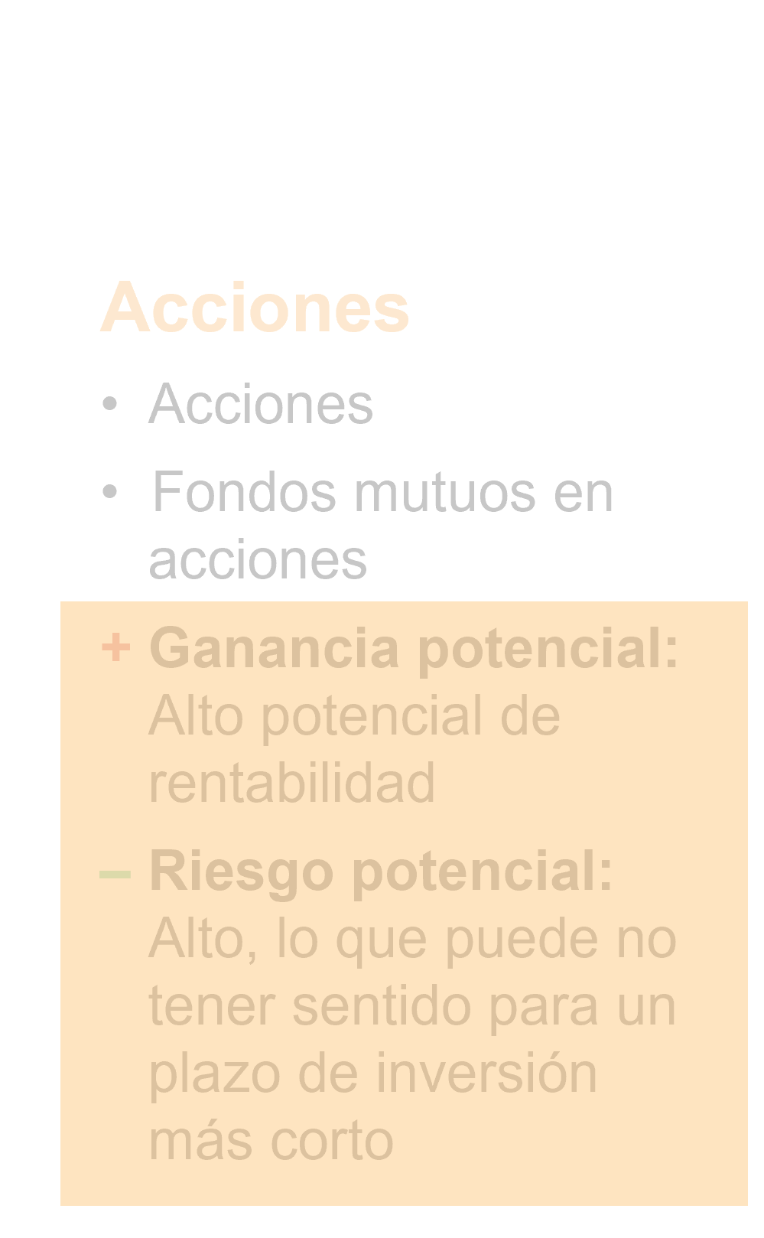
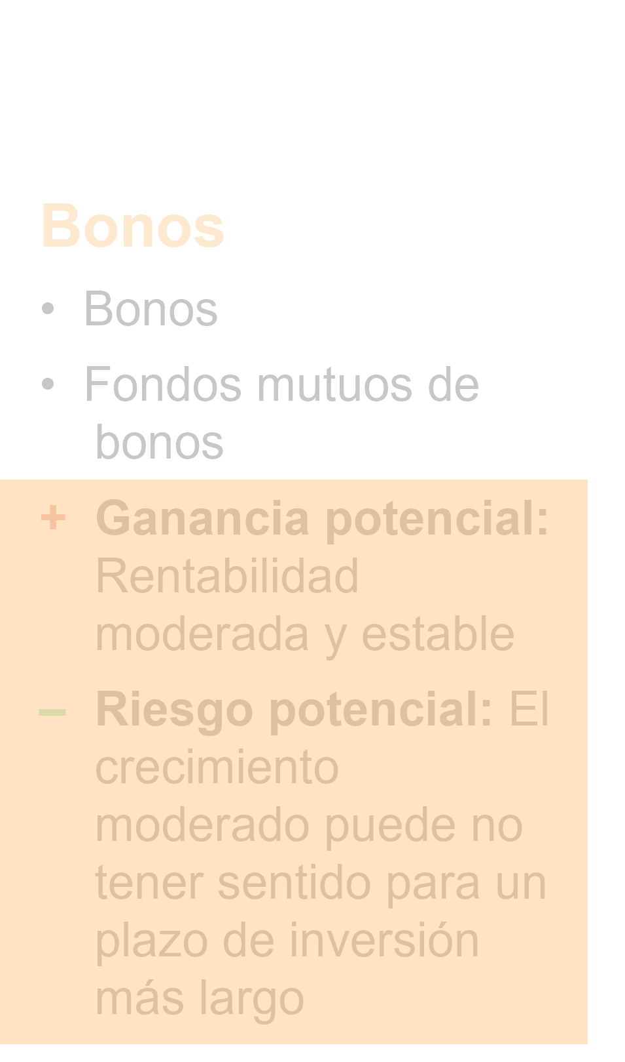
Equivalentes de efectivo
Equivalentes de efectivo
• Fondos de activos estables
• Fondos del mercado monetario
+ Ganancia potencial: Rentabilidad estable y más baja
– Riesgo potencial: El crecimiento lento puede no tener sentido para un plazo de inversión más largo
Con el pensamiento de jubilarse
Notes:
Cash equivalents are investments that allow you to earn interest income and a return on your principal.
A stable asset fund is one example. It gives you a guaranteed return and an appealing crediting rate.
Other types of cash equivalents are money market funds.
There is low risk of losing money with cash equivalents.

Slide 8
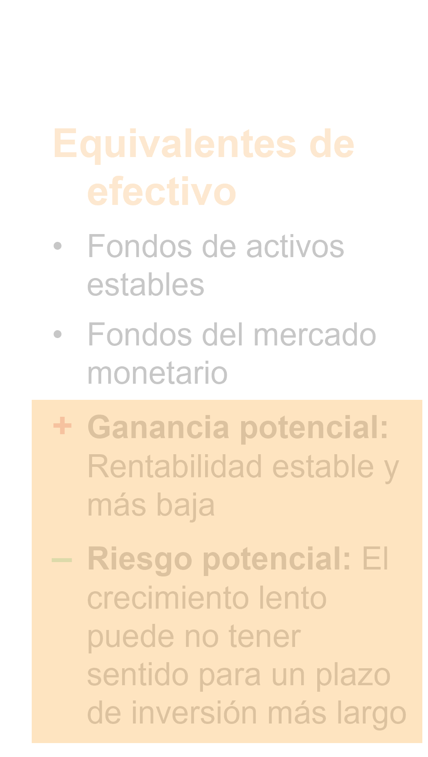
Bonos
Bonos
• Bonos
• Fondos mutuos de bonos
+ Ganancia potencial: Rentabilidad moderada y estable
– Riesgo potencial: El crecimiento moderado puede no tener sentido para un
plazo de inversión más largo
Con el pensamiento de jubilarse
Notes:
Bonds are in the middle of the risk spectrum.
Companies, the U.S. government and other government agencies sell bonds to raise money. When you buy a bond, you’re lending money to the issuer for a set period of time.
Bond issuers pay interest to investors, which is how you earn money on your investment. You can also make money if you sell a bond before its maturity date for more than you paid for it.
You can lose money on bonds if you sell them for less than what you paid. It’s possible to lose money in a bond if the issuer has severe financial problems and can’t repay the debt.

Slide 9
Acciones
Acciones
• Acciones
• Fondos mutuos en acciones
+ Ganancia potencial: Alto potencial de rentabilidad
– Riesgo potencial: Alto, lo que puede no tener sentido para un plazo de inversión más corto
Con el pensamiento de jubilarse
Notes:
Stocks have the highest risk but also the highest potential for making money. Companies sell stock to investors to raise money. When you buy shares of a stock in a company, you become one of the owners.
You can make money on stocks by selling shares for more than you paid. Some companies also pay stockholders regular dividends.
You can lose money on stocks if you sell shares at a lower price than you paid. You can also lose money if the company issuing the stock goes bankrupt or decreases in value.

Slide 10
Riesgos y rentabilidad
Equivalentes de efectivo
Bonos
Acciones
Riesgo potencial
Rentabilidad potencial
Con el pensamiento de jubilarse
Notes:
This chart shows the potential for risk and return for each of the types of investments.

Slide 11
Haga una combinación. Ya sea que tenga apetito de tomar riesgos, o solo desee probarlo, distribuir su dinero entre diferentes grupos de inversión es la clave para gestionar el riesgo.
Notes:
Whether you have a strong appetite for risk or think of yourself as a more conservative investor, diversification is key to managing investment risk.
Diversification means spreading your money to different investments.
You can also diversify within investment groups. Most mutual funds, for example, are automatically diversified. For example, a stock fund may include stocks in many companies with the potential for both losses and gains.
With diversification, the losses you may experience from poorly performing stocks may be balanced out by stocks that perform better than expected.
But remember that diversification doesn’t guarantee a profit or protect against loss in a declining market.

Slide 12
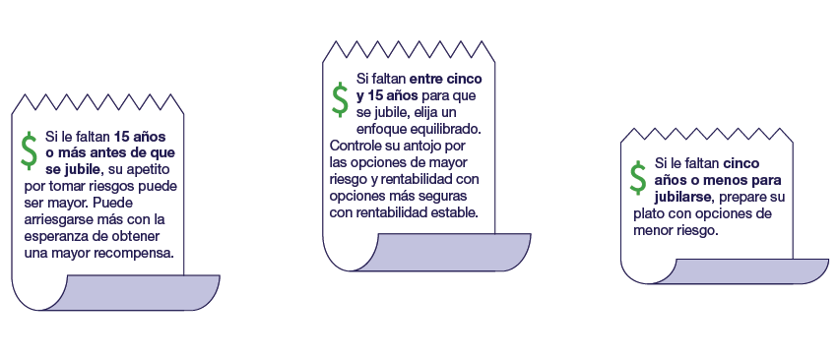


¿Cuántos años le faltan para jubilarse?
Con el pensamiento de jubilarse
Notes:
The number of years you have before retirement can definitely influence your appetite for risk.
If you have 15 years or more before retirement, your appetite for risk may be high. You can take more chances in hopes of a bigger payoff.
If retirement is between five and 15 years away, choose a balanced approach. Even out your craving for higher-risk, higher-return options with safer ones that have more consistent returns.
If you are five or fewer years from retirement, your staple should be lower-risk options.

Slide 13
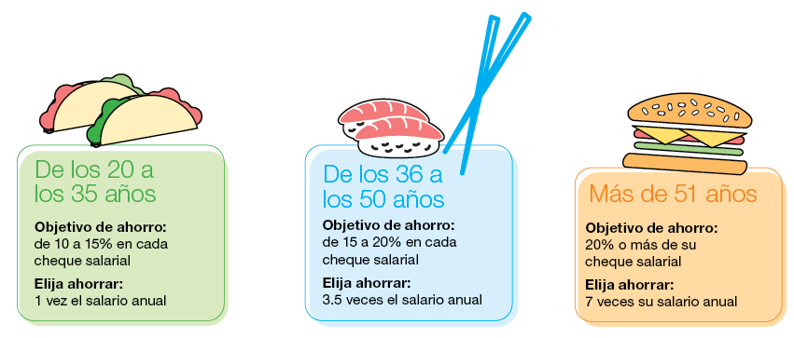
¿Cuánto se debe ahorrar?
Con el pensamiento de jubilarse
Notes:
Check out these guidelines to saving for retirement at each life stage.
For example, the ideal target savings goal for a 45-year-old is 15 to 20 percent of your paycheck.
At this age, you’re in good shape if you have 3.5 times your current annual salary already saved in a retirement account.

Slide 14

¿Por qué unirse a su plan?
Ahorro
automático
Ventajas
fiscales
Opciones de
inversión
Capitalización
Aportaciones
paralelas del empleador
Con el pensamiento de jubilarse
Notes:
[1 Click for each animation]
If you haven't enrolled in your employer's plan, here are five of the best reasons to sign up today:
It’s easy – saving is automatic. Contributions to your retirement plan are taken directly out of your paycheck. This makes saving easy and seamless. And you can take your savings with you if you leave your job.
There are tax advantages. Your contributions are made before taxes are withheld. This reduces your taxable income and income taxes.
Your plan's investment options have been put through a comprehensive review process. This helps ensure that you have a diverse and appropriate selection of options to choose from.
Compounding happens. The earnings on your savings are reinvested and start earning an investment return of their own. The earlier you start saving, the more likely you'll benefit from compounding.
“Free money.” Your employer may match part of your contribution. That means you may be able to double your contributions up to a limit.

Slide 15
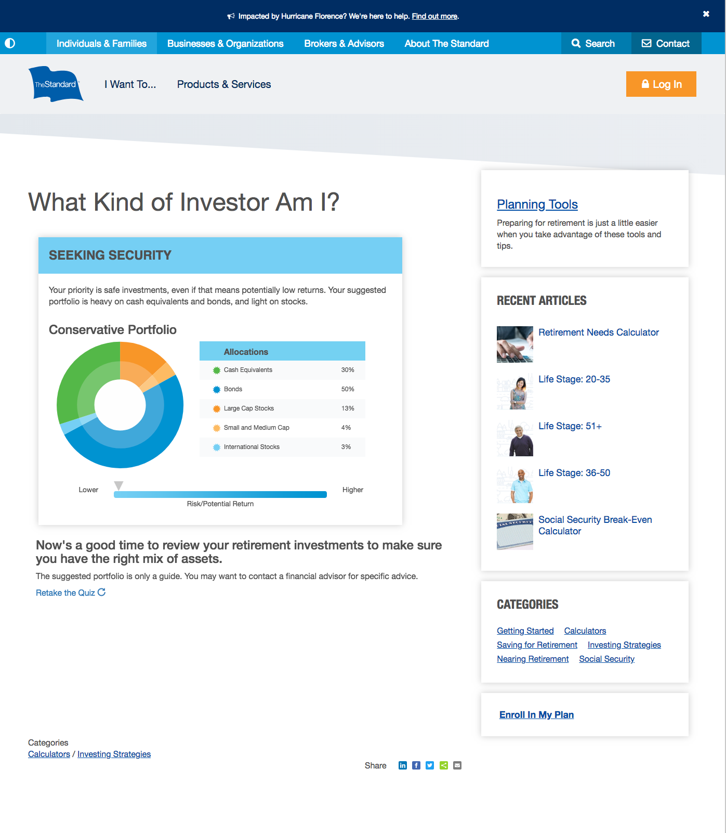
¿Qué tipo de inversor es usted?
Conteste nuestro cuestionario y descúbralo.
Ingrese a standard.com/investorquiz
Con el pensamiento de jubilarse
Notes:
To learn more about your appetite for risk and what kind of investor you are, take our quiz. Go to standard.com/inv.estorquiz

Slide 16

¿Tiene alguna pregunta?
¡Pídalo ya! Inscríbase en su plan de jubilación o aumente su aportación. Ingrese a standard.com/retirement
Con el pensamiento de jubilarse
Notes:
When you’re ready, here’s where to go to enroll in your retirement plan or increase your current contribution:
standard.com/retirement
Thank you for being here today. I’m here to answer questions.

Slide 17
conclusion
Antes de invertir, los empleadores y los participantes del plan deben revisar con atención los objetivos de inversión, los riesgos, los cargos y los gastos de las opciones de inversión que se ofrecen dentro del plan de jubilación. Los folletos de los fondos mutuos individuales en la anualidad colectiva contienen esta información, además de otros datos importantes. Puede llamar al 877.805.1127 para obtener una copia de estos folletos. Por favor, lea detenidamente los folletos antes de invertir. Las inversiones están sujetas al mercado bursátil y su valor es fluctuante.
The Standard es el nombre comercial de StanCorp Financial Group, Inc. y sus subsidiarias. StanCorp Equities, Inc., miembro de FINRA, vende al por mayor un contrato de anualidades colectivo emitido por Standard Insurance Company y una plataforma de fideicomiso de fondos mutuos para planes de jubilación. Standard Retirement Services, Inc. proporciona servicios de documentación financiera y servicios administrativos del plan. Los servicios de asesoría de inversiones son proporcionados por StanCorp Investment Advisers, Inc., que es un asesor de inversiones registrado. StanCorp Equities, Inc., Standard Insurance Company, Standard Retirement Services, Inc., y StanCorp Investment Advisers, Inc., son subsidiarias de StanCorp Financial Group, Inc., y todas son corporaciones de Oregon.
RP 20137-SPU (10/18)

