Slide 1



Financial Health Checkup
Financial Health Checkup
Diagnose your debt and make saving for the future easier
Retirement on the Brain
Notes:
Welcome.
For many of us, a big obstacle to saving for retirement is debt.
We all have some kind of debt.
Mortgage or rent
Student loans
Car payments
Credit cards
After making these kinds of payments each month, how many of you feel like there isn’t much left to invest in a retirement plan?
If you raised your hand, then it may be time for a financial health checkup.
Today, we’d like to focus on debt and ways to lower it. We believe that diagnosing your debt is a great first step toward making it easier to save for the future.

Slide 2


Speakers
First Last Name
Title, The Standard
First Last Name
Title, The Standard
Retirement on the Brain
Notes:
[INTRODUCTIONS]

Slide 3


Everyone has debt
Good Debt
Bad Debt
Mortgage or rent
Student loan
Car loan
Credit card balances
Retirement on the Brain
Notes:
It’s rare not to have any debt during your lifetime. And not all debt is bad.
There’s “good debt,” which is debt that can help you make money and increase your net worth. Financing a house or getting a student loan for college are usually good investments, for example.
If you buy a house, you may eventually sell it at a profit or rent it out to generate income. A college degree is expected to lead to higher earning potential and greater access to good-paying jobs.
Then there’s “bad debt.” These are purchases that won’t go up in value or generate income. High credit card debt to make ends meet or buying a new car are examples.
And remember that the interest you pay for things you buy with a credit card essentially raises the cost of the item.
The interest rates for credit cards are usually significantly higher than for consumer loans, so keeping a balance can get you into trouble quickly.
New cars cost a lot of money and depreciate almost immediately. Consequently, the interest you pay on a car loan can eat up any money you might otherwise save.

Slide 4


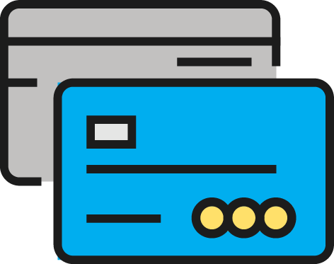

Debt can easily spiral out of control and lead to a financial health crisis.
Retirement on the Brain
Notes:
Whether good or bad, debt can spiral out of control and put you in a financial health crisis.
Like a virus, debt can spread to other areas of your financial life.
Putting all of your hard-earned money toward paying off debt can make it hard to cover even your everyday expenses. And what happens when you have a costly emergency, like if you need to replace a furnace or cover medical bills after an accident?

Slide 5

Did You Know?
The average household that’s carrying credit card debt has a balance of $15,654.
— NerdWallet, 2017
Only 37% of Americans have enough savings to cover a $500
to $1,000 emergency.
— Bankrate, 2016
The average student in the Class of 2016
has $37,172 in student loan debt.
— Federal Reserve Bank of New York, 2016
Retirement on the Brain
Notes:
Think about these money statistics and whether any apply to you.
[READ STATISTICS]

Slide 6

Get a financial health checkup
Diagnose your debt
Retirement on the Brain
Notes:
Your overall financial wellness is important, and managing debt should be high on your list to achieve it.
Lowering your debt can improve your financial health, reduce stress and help make it easier to save for the future.
So let’s learn how to diagnose your debt.
How do you do that?
By calculating your debt-to-income ratio — or DTI. It’s a great way to check that your debt load falls within a healthy range.
Your debt-to-income ratio can help you change some money habits and better manage your debt.
Calculating your DTI also helps your overall financial health, because lenders use it to decide whether to offer you credit and what rate to charge. They pay attention to research that shows people with high DTIs have more trouble making their payments.

Slide 7
Debt-to-Income Ratio (DTI)
Minimum monthly debt payments ÷ monthly income
= DTI%
Retirement on the Brain
Notes:
Here’s what you need to calculate your debt-to-income ratio:
Your online bill-paying history or checkbook register
Monthly bills
Your most recent pay stub
To get your DTI:
List your monthly debt payment amount (credit cards, car loans)
and
Divide by your monthly income before taxes.
The percentage you get is your monthly debt-to-income ratio.

Slide 8

DTI Example
James
40 years old
Earns $48K a year
Retirement on the Brain
Notes:
Let’s look at an example. Here we have James, who’s 40 years old and earns $48,000 a year.

Slide 9
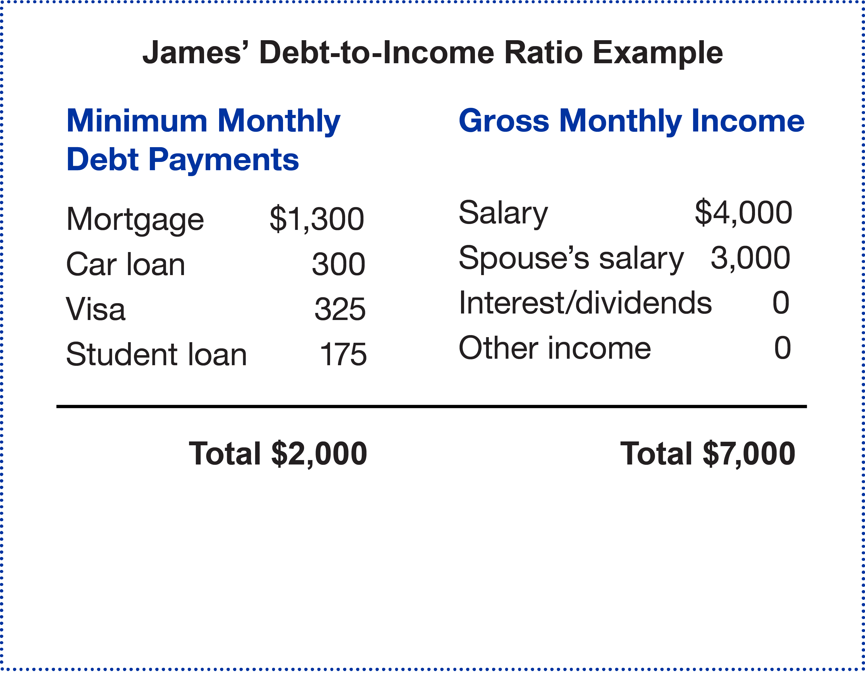
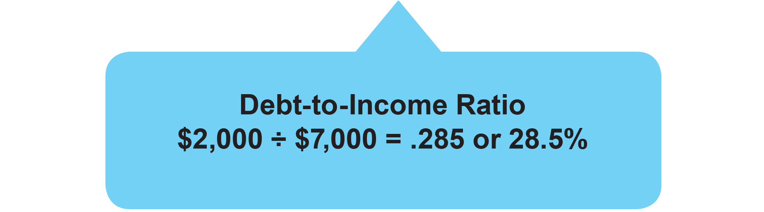
James’ Debt-to-Income Ratio Example
Retirement on the Brain
Notes:
James’ debts include a mortgage, car loan, credit cards and a student loan. They total $2,000 a month.
He and his wife make a combined gross income of $7,000 a month.
When you do the calculation, his debt-to-income ratio is 28.5 percent.
Let’s see whether that falls within a healthy range.

Slide 10

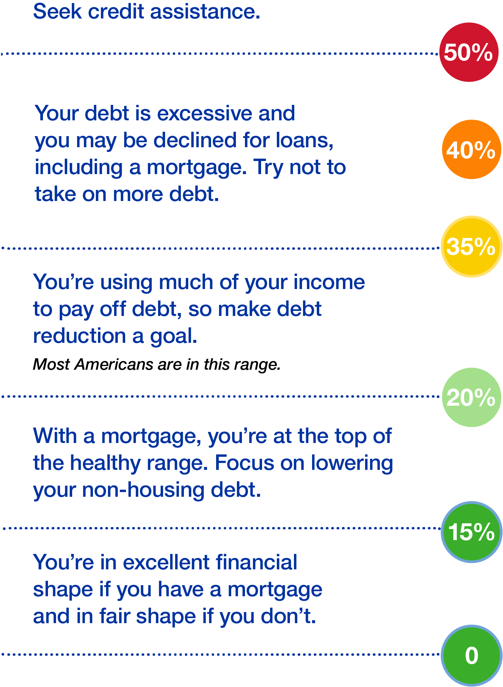
Debt-to-Income Range Chart
James’
Debt-to-Income Ratio
Retirement on the Brain
Notes:
James’ debt-to-income ratio of 28.5% falls in the most common range for most Americans.
While saving should be a high priority for James, lowering debt may be a more important goal.
[REVIEW THERMOMETER RANGES]
If you don't have a mortgage, keep in mind that paying your rent on time and paying credit card bills on time are actions that help you establish a good credit history. They also contribute to your overall financial wellness.

Slide 11


Remedies to Lower Your Debt
High Interest
Regimen
Small Balance
Therapy
Focus on high-interest debts
Focus on your smallest debts
Notes:
It’s pretty easy to figure out your debt-to-income ratio, right?
It’s great because it gives you a snapshot of your financial health.
Now let’s talk about remedies for reducing your debt.
There are two basic ones, and both can help you improve your overall financial health.
The High Interest Regimen, also called Debt Avalanche, targets your highest-interest-rate debts first. It lets you repay debts in the shortest amount of time and saves you the most in interest.
The Small Balance Therapy, also known as the Debt Snowball method, targets your smallest debts first, no matter the interest rate. If you’re motivated by small victories, this remedy helps you gain the momentum to reach financial wellness.
Choose the method that helps you feel more balanced financially.

Slide 12




Heal and Restore with
Debt-Reduction Tools
Search online for
Websites
Apps
Software
Spreadsheets
Notes:
Lowering your debt is easier with the right tool. Explore these options.
Websites include calculators that can help you figure out which debts to pay down first and how soon you might pay off a debt.
Apps can help you set up automatic bill paying, to avoid the risk of late payment fees. They also help you set up budgets, so you can always be saving.
Software and spreadsheets let you plug in all of your debt information and come up with a payment plan that makes sense for you.

Slide 13
Good Money Habits to Follow Now
Whenever you can, use cash — not credit — for purchases.
Set up automatic bill pay to avoid late-payment charges,
which can add up.
Use extra cash — like bonuses and pay raises — to
reduce the principal on loans.
Explore ways to lower the interest rate on your
credit cards and loans.
Notes:
[READ HABITS]
[EXPAND ON LAST BULLET]
Take the initiative and contact your credit card company. It's not unheard of to negotiate a lower interest rate, especially if your payment history is good.
And if you have more than one credit card, take steps to consolidate your balances on a card with the lowest interest rate.
Taking steps to reduce your debt now can help you save money and interest over time.

Slide 14
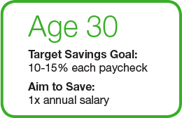
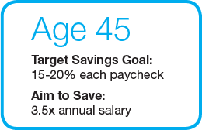
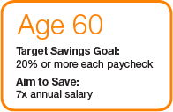
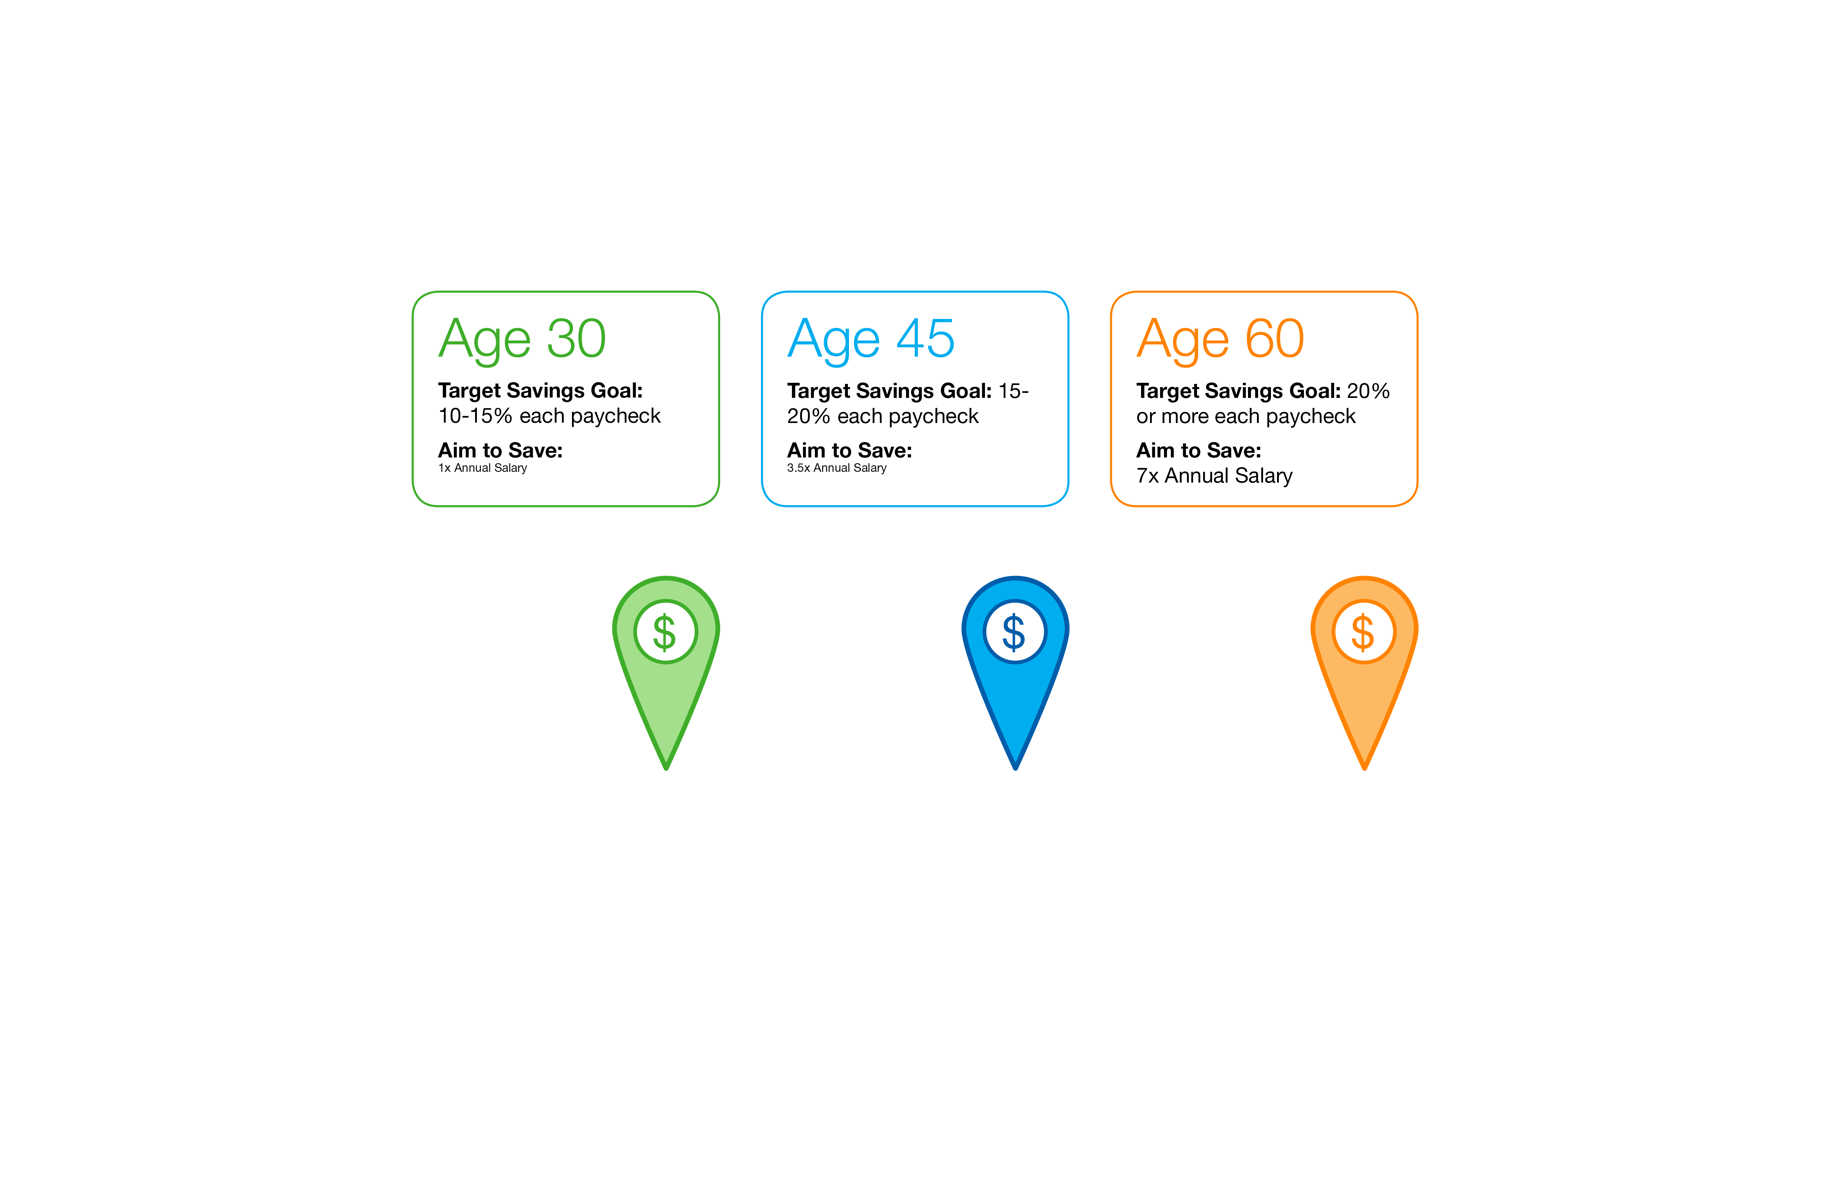
Saving Mileposts
Notes:
When you’ve set up a plan to lower your debt, you’re on your way to removing obstacles to saving. Don’t wait to enroll in your company’s retirement plan, or increase your contribution if you’re already enrolled. Check out these guidelines to saving for retirement at each life stage.
We’ve consulted expert sources to find these suggested guidelines for saving when you’re 30, 45 and 60.
As an example, the ideal target savings goal for a 45-year-old is 15 to 20 percent of your paycheck.
At this life stage, you're in good shape if you have 3.5 times your current annual salary already saved in a retirement account.

Slide 15



Reasons to Save
Money for
Major Purchases
Money to Live On
Money for Fun
Notes:
Why is saving for retirement important?
Well, when we stop getting a regular paycheck, we still have to cover many of the same expenses we have now. And some new ones, too.
In retirement, we need:
Money to live on
Rent or mortgage
Food and necessities
Utilities and other expenses
Insurance
Transportation
Medical expenses
Money for fun
Travel expenses
Club memberships
Hobbies and activities
Money for major purchases
Car
Home projects
Real estate
Technology, like new phones and computers
How will you cover these expenses?

Slide 16

Join Your Company’s Retirement Plan
Retirement on the Brain
Notes:
One of the best answers is to join your company’s retirement plan.

Slide 17


Why Join Your Plan?
Automatic
Savings
Tax
Advantages
Investment
Options
Compounding
Employer
Match
Notes:
[1 Click for Animation]
Here are 5 of the best reasons to enroll in your plan:
It’s easy — saving is automatic. Contributions to your retirement plan are taken directly out of your paycheck. This makes saving easy and seamless. And you can take your savings with you if you leave your job.
There are big tax advantages. Your contributions are made before taxes are withheld. This reduces your taxable income and income taxes.
We've screened and evaluated the investment options in your plan during a thorough review process. This helps ensure that you have a diverse and appropriate selection of options to choose from.
Compounding happens. The earnings on your savings are reinvested and start earning an investment return of their own. The earlier you start saving, the more you’ll benefit from compounding
“Free money.” Your employer may match part of your contribution. That means you may be able to double your contributions up to a limit.
[1 Click for Animation to Next Slide]

Slide 18


Ready for Retirement
Save now. It’s easy.
Retirement on the Brain
Notes:
Good financial health is worth striving for.
And easy steps like diagnosing your debt can help you lower your debt and find ways to save for the future.

Slide 19

Questions?
Go to standard.com/retirement to enroll in your plan
or increase your contribution.
Retirement on the Brain
Notes:
I hope we’ve given you ideas about managing your debt and finding money to save for retirement.
When it comes time to retire, you’ll be thankful that you completed this financial health checkup.
Here’s where to go to enroll in your retirement plan: standard.com/retirement
Thank you for being here today. I’m here to answer questions.

Slide 20
The conclusion
Employers and plan participants should carefully consider the investment objectives, risks, charges
and expenses of the investment options offered under the retirement plan before investing. The prospectuses for the individual mutual funds in the group annuity contain this and other important information. Prospectuses may be obtained by calling 877.805.1127. Please read the prospectus carefully before investing. Investments are subject to market risk and fluctuate in value.
The Standard is the marketing name for StanCorp Financial Group, Inc., and its subsidiaries.
StanCorp Equities, Inc., member FINRA, wholesales a group annuity contract issued by Standard Insurance Company and a mutual fund trust platform for retirement plans. Standard Retirement Services, Inc. provides financial recordkeeping and plan administrative services. Investment advisory services are provided by StanCorp Investment Advisers, Inc., a registered investment advisor. StanCorp Equities, Inc., Standard Insurance Company, Standard Retirement Services, Inc., and StanCorp Investment Advisers, Inc., are subsidiaries of StanCorp Financial Group, Inc., and all are Oregon corporations.
RP19647 3/18

