Slide 1
Ahorro para el futuro
Con el pensamiento de jubilarse
Notes:
[1 Click for Animation]
Welcome.
You’re here today because your employer offers a retirement plan. It’s a great way to save now to cover your living expenses in the future.
You may or may not be enrolled in your plan, but either way, one big question may be on your mind.
“How much should I save?”
If this feels like a big question to tackle, put your worries aside.
Today, we’re going to move together through some simple steps to help you come up with an answer.

Slide 2
¿Por qué no estamos ahorrando para la jubilación?
No sé cuánto ahorrar.
Es muy difícil iniciar.
Estoy cerca de jubilarme. Es demasiado tarde para empezar a ahorrar.
Espero estar bien con mis subsidios del Seguro Social.
Aún falta mucho para jubilarme.
Notes:
Saving for retirement can feel challenging. A lot of us feel that way.
While many Americans have access to a workplace retirement plan, they may not feel ready for retirement.
Why aren’t we saving for retirement?
The reasons may sound familiar to you. Which of these do you hear in your head?
“It’s too hard to get started.”
“Retirement is a long ways off.”
“I’m close to retiring. It’s too late to start saving.”
“I’m hoping I’ll be fine on my Social Security benefits.”
“I don’t know how much to save.”
We’ll talk more in a bit about some of these reasons – and how we can easily help you get past them.

Slide 3
Razones para ahorrar
Dinero para adquisiciones mayores
Dinero para compras esenciales
Dinero para la recreación
Notes:
Let’s talk about what your costs will be when you are retired.
When you stop working and stop getting a regular paycheck, you’ll still have some of the same expenses you have now. And new ones, too.
Here’s what you’ll need:
Money to live on
Rent or mortgage
Food and necessities
Utilities and other expenses
Insurance
Transportation
Money for fun
Travel expenses
Club memberships
Hobbies and activities
Money for major purchases
Car
Home projects
Real estate
Technology, like new phones and computers
How will you cover these expenses?

Slide 4
Más razones para ahorrar
Puede aumentar casi un 5.5% al año
Reemplaza únicamente el 40% del salario actual
Un promedio del 3% al año
Atención médica
Inflación
Beneficios del Seguro Social
Notes:
There are a few other important reasons to be saving.
[1 Click for Animation Showing Stats]
Health-care costs are a big one.
Retiree health care costs are expected to rise by nearly 5.9% throughout one’s retirement years.*
So give some thought about how you will pay to stay healthy in retirement.
And what about inflation?
The cost of everything we buy and services we use typically increase year over year. Generally, we expect that things will cost more when you retire, compared to what they cost today.
For those of you who plan to retire on your Social Security benefits, remember that these benefits are not designed to cover all of your needs in retirement.
How will you make up the difference?

Slide 5
¿Por qué unirse a su plan?
Ahorro automático
Ventajas fiscales
Opciones de inversión
Capitalización
Igualación del empleador
(si está disponible)
Notes:
[1 Click for Animation]
So let’s look back at one of the reasons we aren’t saving.
“It’s too hard to get started” is one I hear a lot.
But the reality is your employer’s retirement plan is easy to join. It takes just minutes to get online and enroll – with any amount.
It’s easy to change your contribution when you decide to increase your savings rate. You can make changes any time.
And tracking your balance and investments doesn’t take a lot of effort.
Need more reasons to enroll in your plan? Here are 5 of the best ones:
It’s easy – saving is automatic. Contributions to your retirement plan are taken directly out of your paycheck. This makes saving easy and seamless.
There are big tax advantages. Your contributions are made before taxes are withheld. This reduces your taxable income and income taxes.
You have control over your investments. You decide how and where to invest. And you can take your savings with you if you leave your job.
Compounding is cool. The earnings on your savings are reinvested and start earning an investment return of their own. The earlier you start saving, the more you’ll benefit from compounding.
“Free money.” OK, not really, but your employer may match part of your contribution. That means you may be able to double your contributions up to a limit.
[1 Click for Animation to Next Slide]

Slide 6
¿Por qué unirse a su plan?
Ahorro automático
Ventajas fiscales
Control de inversiones
Capitalización
Igualación del empleador
Notes:
So let’s look back at one of the reasons we aren’t saving.
“It’s too hard to get started” is one I hear a lot.
But the reality is your employer’s retirement plan is easy to join. It takes just minutes to get online and enroll – with any amount.
It’s easy to change your contribution when you decide to increase your savings rate. You can make changes any time.
And tracking your balance and investments doesn’t take a lot of effort.
Need more reasons to enroll in your plan? Here are 5 of the best ones:
It’s easy – saving is automatic. Contributions to your retirement plan are taken directly out of your paycheck. This makes saving easy and seamless.
There are big tax advantages. Your contributions are made before taxes are withheld. This reduces your taxable income and income taxes.
You have control over your investments. You decide how and where to invest. And you can take your savings with you if you leave your job.
Compounding is cool. The earnings on your savings are reinvested and start earning an investment return of their own. The earlier you start saving, the more you’ll benefit from compounding.
“Free money.” OK, not really, but your employer may match part of your contribution. That means you may be able to double your contributions up to a limit.

Slide 7
Cuánto necesitará
¿Cuánto necesitará en su jubilación?
¡80% a 90% de sus ingresos actuales!
Dicen los expertos.
Notes:
So how much will you need in retirement?
Experts generally agree that most of us will need 80 to 90 percent of our current income to live a similar lifestyle in retirement.
Will you need closer to 80 percent or more like 90 percent? That’s hard to predict.
Some of us plan to retire easy, maybe downsize to a smaller house with fewer expenses and work in the garden as much as we can.
Others might have plans to travel for six months out of the year to far off destinations or buy a second house in a warmer part of the country.
Spend a few minutes picturing what you might do in your retirement? Do you think you’ll want to:
Travel far
Earn a degree
Volunteer for your favorite non-profit
Complete projects in your home
Play golf
Work part-time
How you might spend your retirement will help determine how much you’ll need financially.

Slide 8
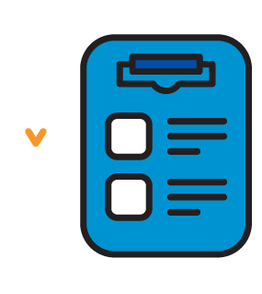
Cuánto necesitará
Notes:
Let’s take a quick quiz to help you get even closer to figuring out how much you’ll need in retirement.
Then we’ll be a step closer to our goal – figuring out how much to save now.

Slide 9
Responda 6 preguntas
0
Si la respuesta es "menos"
1
Si la respuesta es "lo mismo"
2
Si la respuesta es "más"
Notes:
I’m going to ask you questions about these 6 topics.
Use this scoring system for each answer and keep track as we go along.
Add 0 if your answer is Less
Add 1 is your answer is Same
Add 2 if your answer is More
[1 Click for Animation to Next Slide]

Slide 10
Responda 6 preguntas
Deudas
0
Si la respuesta es "menos"
Hipoteca o alquiler
1
Si la respuesta es "lo mismo"
Viajes
Adquisiciones mayores
2
Si la respuesta es "más"
Entretenimiento
Atención médica
Notes:
Here are the questions. [1 Click for each question ]
Do you think you’ll have less, the same or more debt in retirement than you have now? (Think about loans, credit cards, etc.)
When you’re retired, will your mortgage or rent payment be less, the same or more than now?
What about travel? Will you do less, the same or more when you’re retired?
Think about major purchases. Do you think you’ll be making fewer, the same or more big purchases in retirement? (Ex. Remodel house, computer, car, beach home, new roof.)
Do you plan to spend less, more or the same on entertainment and other recreational activities?
And what about health care and other insurance. Do you think you’ll be spending less, the same or more when you’re no longer working?
[1 Click for last check mark]

Slide 11
Puntuación de su cuestionario
Porcentaje aproximado
de los ingresos actuales necesarios
Puntaje
0-4
80%
5-7
90%
8-10
100%
11-12
110%
Notes:
Look for your total score on the left and find your percentage. Maybe you came up with 80%.
Multiply that percentage with your current annual income to get a dollar amount.
This is an estimate of what you’ll need to live on each year in retirement.
The next step is figuring out how much to save now so you can reach that goal. I can help you do that next.

Slide 12
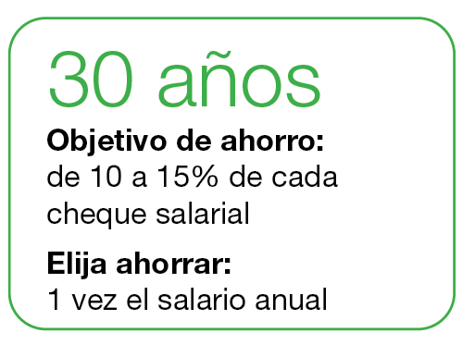
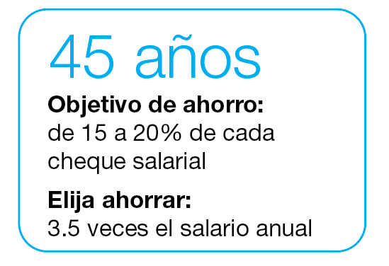
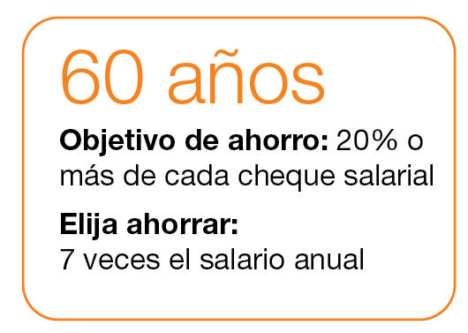
Metas de ahorro
Notes:
We’ve consulted expert sources to find these suggested guidelines for saving when you’re 30, 45 and 60.
As an example, the ideal target savings goal for a 45-year-old is 15 to 20 percent of your paycheck.
You’re in good shape if you have 3.5 times your current annual salary already saved in a retirement account.

Slide 13
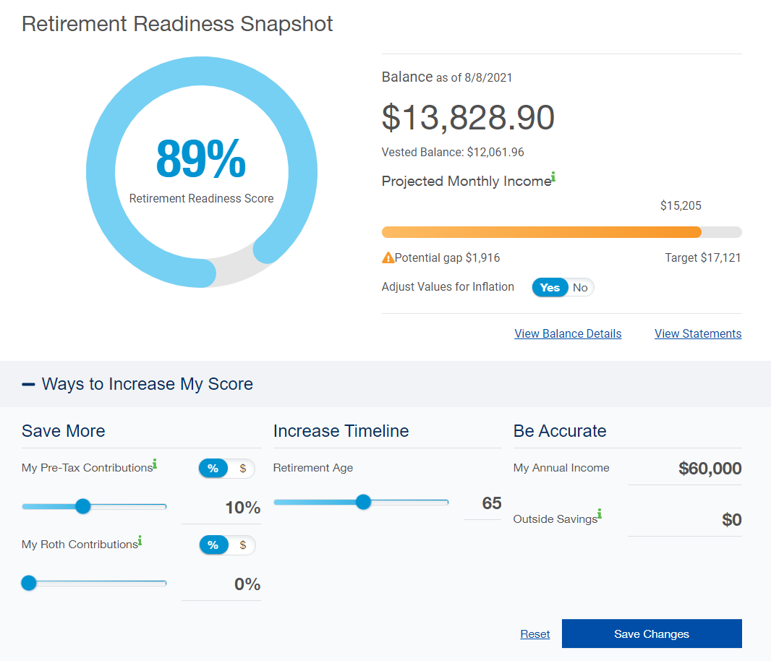
Ahorro para el futuro
Visite www.standard.com/retirement para consultar su Retirement Readiness Snapshot [Imagen de preparación para la jubilación].
Notes:
We know that many of you came here wondering how much you should save.
If you visit standard.com/retirement, you can log in to your Personal Savings Center account. There you’ll see a helpful Retirement Readiness Snapshot. By adjusting the sliders and adding your income and outside savings, you can see how much you need to save for the future.
You may discover that you can afford to contribute on a regular basis. Investing even a small amount of your pay can make a big difference at retirement.
To save more, simply click Save Changes.
If you haven’t enrolled yet, you can click Save Changes to be quickly enrolled in the plan’s default investment at the contribution you choose. Or you can enroll online the regular way.
The sooner you start saving, the easier it will ‭be to prepare for retirement.
Thank you for your time

Slide 14
Conclusion
Únicamente con fines educativos. Nada de lo expuesto en esta presentación debe considerarse asesoramiento en materia de inversión.
Antes de invertir, los empleadores y los participantes del plan deben revisar con atención los objetivos de inversión, los riesgos, los cargos y los gastos de las opciones de inversión que se ofrecen dentro del plan de jubilación. Los folletos de los fondos mutuos individuales en la anualidad colectiva contienen esta información, además de otros datos importantes. Puede llamar al 877.805.1127 para obtener una copia de estos folletos. Por favor, lea detenidamente los folletos antes de invertir. Las inversiones están sujetas al riesgo bursátil y su valor puede fluctuar.
The Standard es el nombre comercial de StanCorp Financial Group, Inc. y sus subsidiarias. StanCorp Equities, Inc., miembro de FINRA, vende al por mayor un contrato de anualidades colectivo emitido por Standard Insurance Company y una plataforma de fideicomiso de fondos mutuos para planes de jubilación. Standard Retirement Services, Inc. proporciona servicios de documentación financiera y servicios administrativos del plan. Los servicios de asesoría de inversiones son proporcionados por StanCorp Investment Advisers, Inc., un asesor de inversiones registrado. StanCorp Equities, Inc., Standard Insurance Company, Standard Retirement Services, Inc. y StanCorp Investment Advisers, Inc., son subsidiarias de StanCorp Financial Group, Inc., y todas son corporaciones de Oregon.
RP 19356
SPU
(8/21)

