Slide 1
Saving For Your Future.
Take simple steps now to make a splash in your financial security.

Slide 2
Where Does Your Future Fit?
Notes:
It can be tough to think about saving for the future when there are so many other things competing for your paycheck.

Slide 3
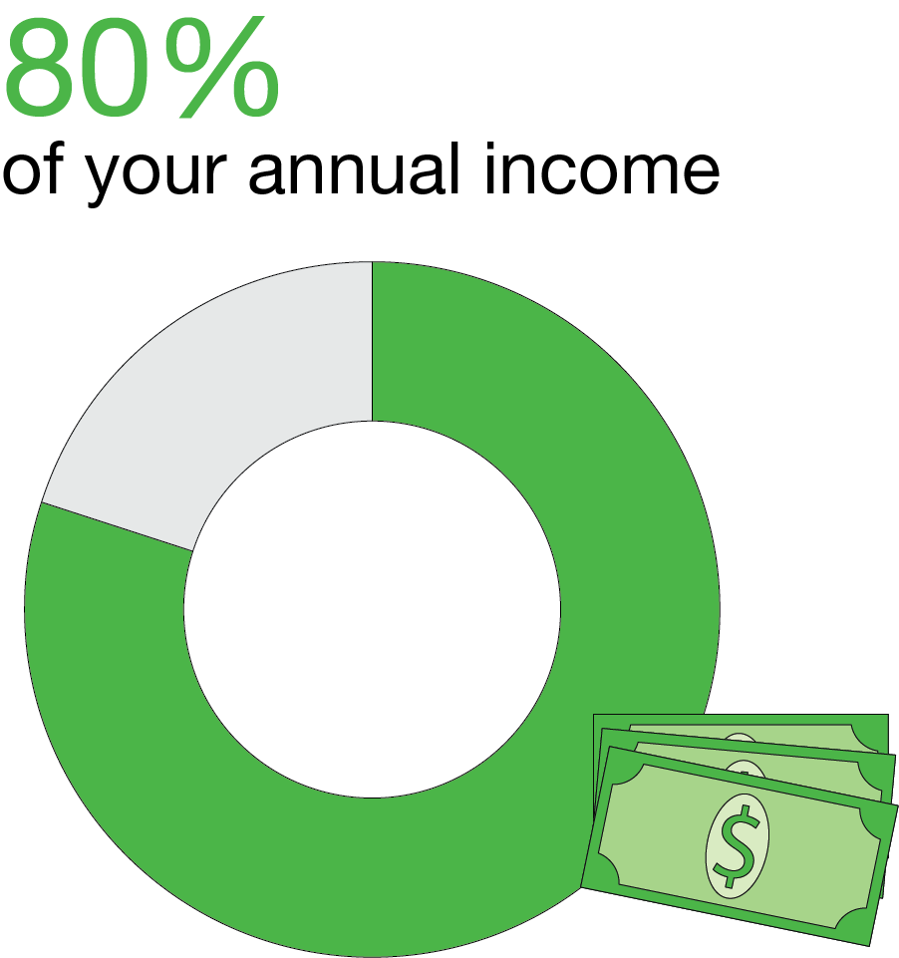
Why Save?
Notes:
Whatever you plan for your non-working years, you will have basic expenses to cover ― costs that your paycheck once addressed. These can include things like food, healthcare and your home. So, even if it feels like a challenge to save for retirement, it is important to make plans to set some money aside. Many experts believe you will need to replace at least 80 percent of your current income in retirement with your savings.

Slide 4
Take Steps Toward Financial Strength
Today, you’ll learn how to:
Look at your income and expenses
Find ways to save for tomorrow — without sacrificing your current quality of life
Notes:
Read slide.

Slide 5
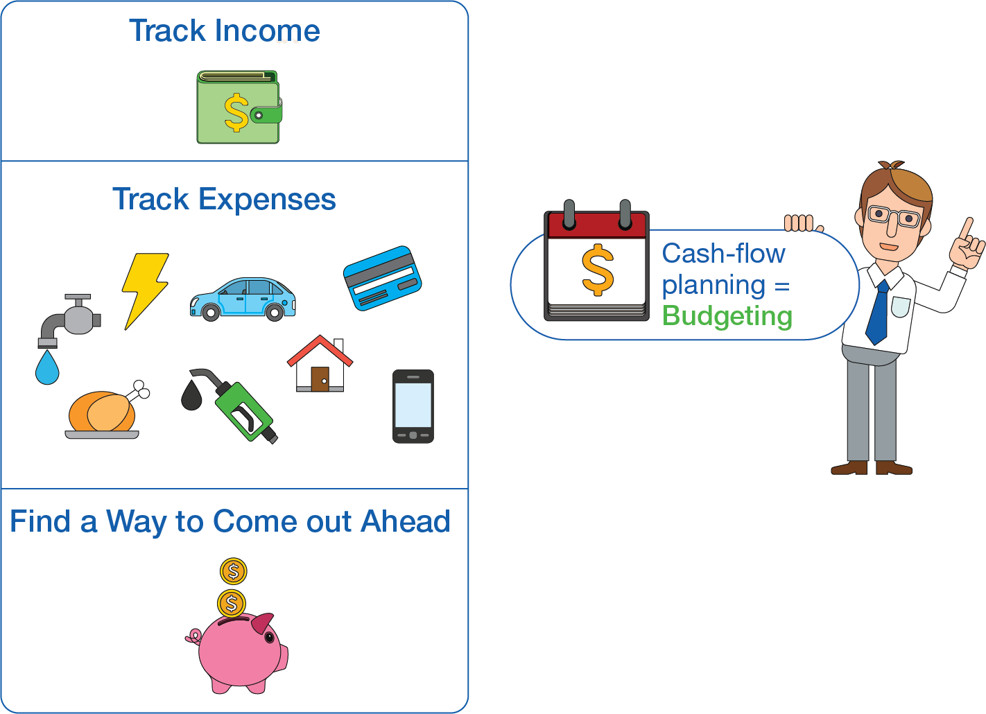
Budgeting
Notes:
Creating a budget is an important step in “finding” money to save. Identify the money you’re bringing in each month and track your expenses.
Even small changes in your daily spending can — pretty painlessly — help you find money to save for your future.

Slide 6
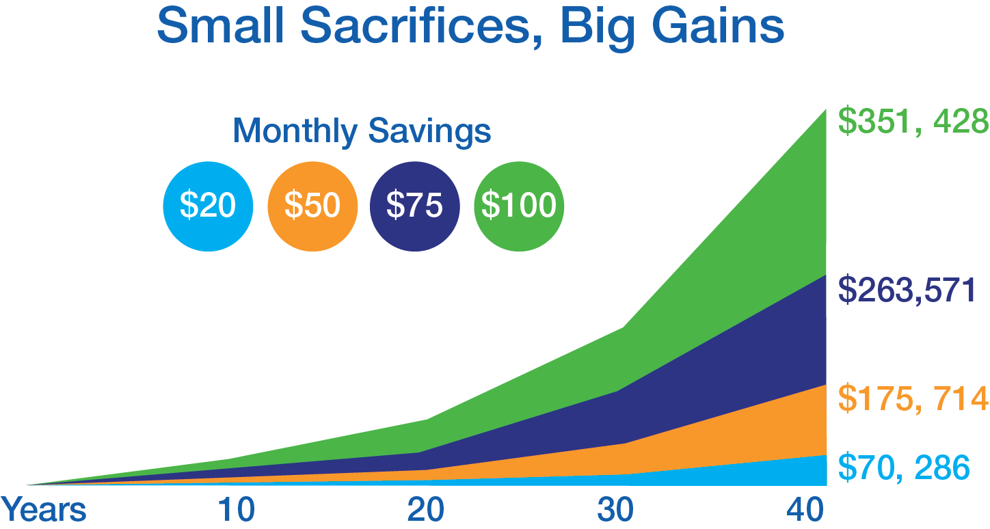
Can You Save $20? $50?
This chart is hypothetical and for illustrative purposes only and is not intended to be a projection of future values of any product. This illustration assumes an average annual rate of return equivalent to 8 percent, compounded monthly. The investment return and principal value of an investment will fluctuate and an investor’s interest, when redeemed, may be worth more or less than the original investment. Past performance is no guarantee of future results.
Notes:
Read slide.

Slide 7
Finding Money Painlessly
Other Ways to Free-up Money
Walk, bike or use public transportation
Refinance credit cards, installment loans and mortgage rates
Discontinue unused subscriptions, memberships
Use the library
Take advantage of coupons or discounts
Small items to occasionally give up:
Notes:
Small items to occasionally give up can include:
Coffee or smoothie
Eating out
Movie ticket or rental
Vending machine soda
Here are a few ideas to get you going:
Visit local movie theater on discount days or early in the day when tickets cost less.
Place a hold on latest bestseller at local library.
Take advantage of two-for-one dinner specials.

Slide 8
Avoid Five Common Spending Mistakes
Spending on impulse
Borrowing against your future
Buying new, not used
Blowing the budget on unexpected bills
Buying the newest, the biggest, the best
Notes:
Here are five common spending mistakes:
Buying on impulse. Take 24 hours to “cool down” before making big purchase.
Borrowing against your future. Don’t buy small purchases on credit or neglect to fund retirement.
Buying new, not used. Consider buying used, especially high-ticket items like cars and boats.
Blowing the budget on unexpected bills. Set aside money for unplanned emergencies.
Buying the newest, the biggest, the best. Peace of mind from living within your means outweighs the short-term thrill (and long-term anxiety) of an upscale lifestyle.

Slide 9
You Can Save $20!
Employer match
If you’re not contributing, you’re leaving money on the table
Incentive to save
Annual salary |  | $30,000
Your contribute | $20 | $1,040
Employer match | $20 | $1,040
Total contributions | $40 | $2,080 per year
RM to customize slide
… and you get $40!
Notes:
Read slide.

Slide 10
Take it to Another Level
Gather your records.
Add it all up.
Don’t forget the tax man.
Categorize expenses.
Find the bottom line.
If you have a little extra, consider redirecting a portion of it into your 401(k) account.
Notes:
Here are ways you can take your savings to another level:
Gather your records. Gather income and spending records (receipts, checkbook registers, statements, etc.).
Add it all up. Add up all sources of income (wages, interest, dividends, etc.).
Don’t forget the tax man. Taxes include federal, state, local and FICA (Social Security and Medicare).
Categorize expenses. Use a spending diary or expense worksheets to review expenses.
Find the bottom line. Determine if your bottom line has excess income or expenses.

Slide 11
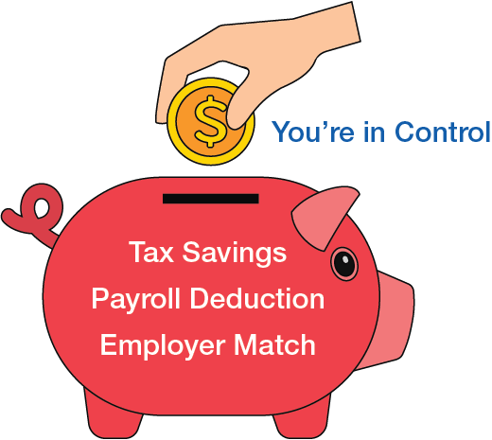
Benefits of Your Retirement Plan
Notes:
ER MATCH VERSION
Here are some benefits of your retirement plan:
Payroll deduction makes it simple to save.
You’re in control of how much to contribute.
Tax savings come with each paycheck.
Your employer matches a portion of your contribution.

Slide 12
Benefits of Your Retirement Plan
Notes:
NO ER MATCH VERSION
Here are some benefits of your retirement plan:
Payroll deduction makes it simple to save.
You’re in control of how much to contribute.
Tax savings come with each paycheck.

Slide 13
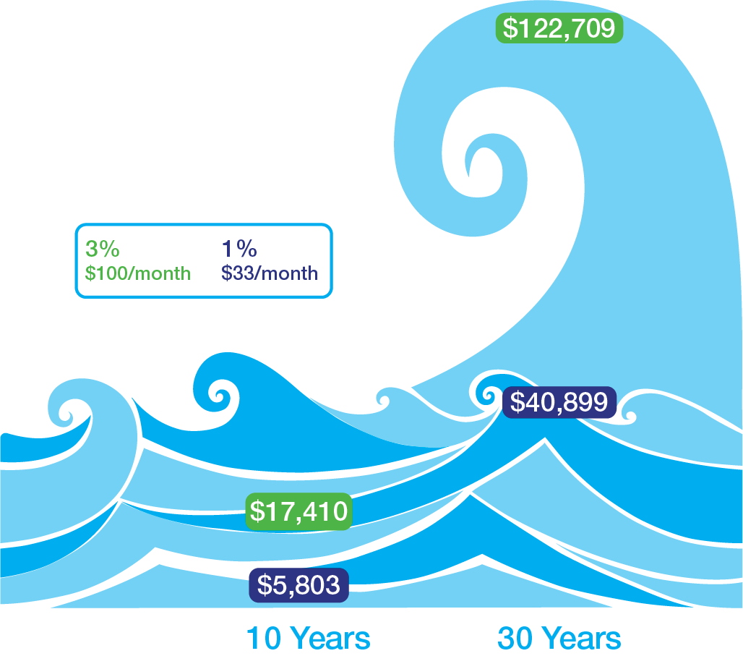
Small Increase, Big Difference
A small increase in your retirement contribution level could mean thousands of dollars over time.
This example is hypothetical and for illustrative purposes only and is not indicative of the performance of any specific investment. Investments are subject to market risk and fluctuate in value. All contribution amounts are based on a $40,000 annual salary and assume a 7 percent rate of return compounded monthly.
Notes:
Read slide.

Slide 14
Getting Started is Easy!
Three months of service and quarterly entry
Your employer will match what you contribute:
100 percent up to $20 per pay period
RM to customize slide
Notes:
Read slide.

Slide 15
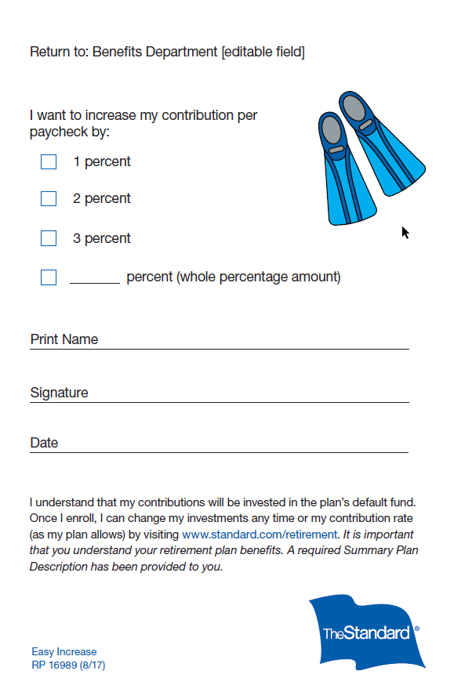
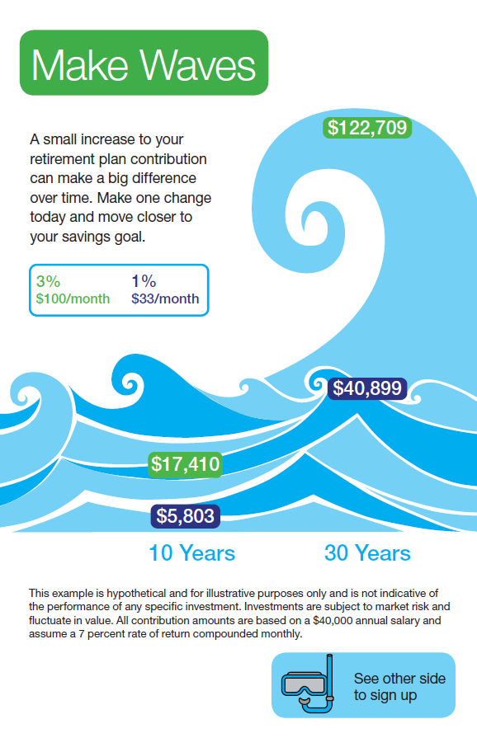
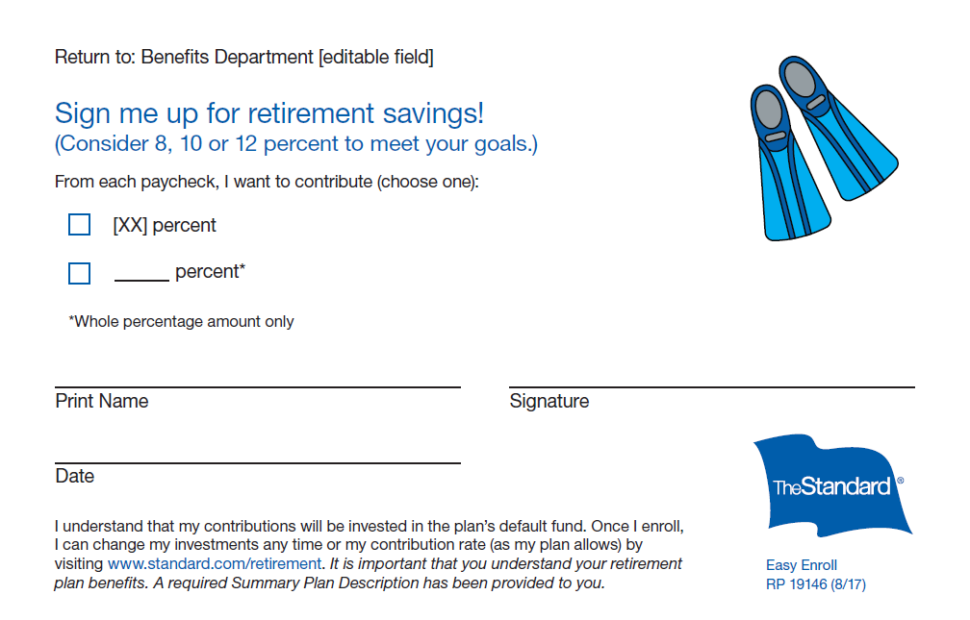
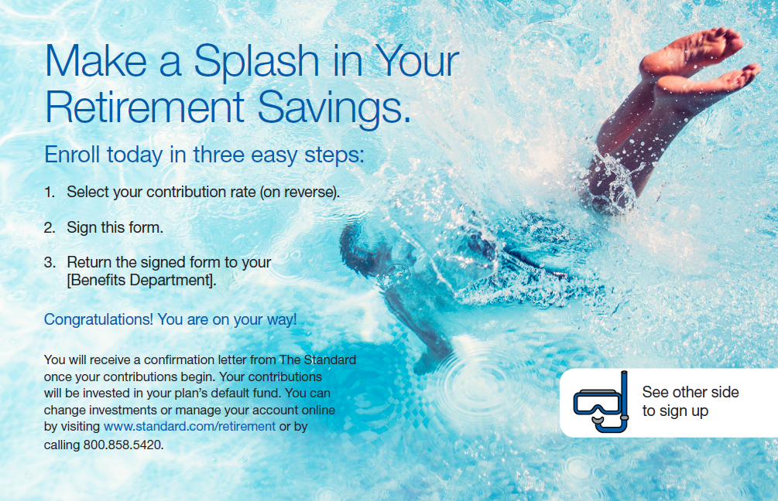
Take Action Today!
Use the Easy Enrollment or Easy Increase postcard.
Give this postcard to your Human Resources department.
You are done!
Notes:
If you are not participating in your 401(k) plan or would like to increase your contribution, do it today.

Slide 16
Additional Resources
The U.S. Financial Literacy and Education Commission ww.mymoney.gov
Choose to Save: A program of the Employee Benefit Research Institute
www.choosetosave.org
Notes:
Read slide.

Slide 17
Disclosures
Employers and plan participants should carefully consider the investment objectives, risks, charges and expenses of the investment options offered under the retirement plan before investing. The prospectuses for the individual mutual funds and each available investment option in the group annuity contain this and other important information. Prospectuses may be obtained by calling 877.805.1127. Please read the prospectus carefully before investing. Investments are subject to market risk and fluctuate in value.
The Standard is the marketing name for StanCorp Financial Group, Inc., and its subsidiaries. StanCorp Equities, Inc., member FINRA, wholesales a group annuity contract issued by Standard Insurance Company and a mutual fund trust platform for retirement plans. Third-party administrative services are provided by Standard Retirement Services, Inc. Investment advisory services are provided by StanCorp Investment Advisers, Inc., a registered investment advisor. StanCorp Equities, Inc., Standard Insurance Company, Standard Retirement Services, Inc., and StanCorp Investment Advisers, Inc., are subsidiaries of StanCorp Financial Group, Inc., and all are Oregon corporations.
Easy Enrollment / Increase
RP 16991 (9/17)

