Slide 1
Retirement on the Brain® Basics of the Financial Markets
Presented by StanCorp Equities, Inc., member FINRA

Slide 2
Presented by…
[Presenter’s name]
[Presenter’s title]
[Presenter’s name]
[Presenter’s title]

Slide 3
Being ready
In this workshop you will learn about:
Investment markets
The Dow and other market indexes
Investment categories
Investment options
Timing the market
Timing in the market
Basics of the Financial Markets

Slide 4
What are the markets anyway?
Securities are traded in facilities or online:
New York Stock Exchange (NYSE)
National Association of Securities
Dealers Automated Quotations (NASDAQ)
London Stock Exchange
Tokyo Stock Exchange
Basics of the Financial Markets

Slide 5
Why is the Dow a media darling?
Leading market indicator
Barometer (index) of nation’s financial mood
Gauge of investment performance
One of oldest continuing U.S. market indexes
You can’t invest in an index such as the Dow; however, you can use indexes to gauge the performance of all types of investments.
Basics of the Financial Markets

Slide 6
Learning more about the Dow
Created in 1896 by
Charles Dow
Tracks 30 large companies –
a “who’s who” of American
businesses
Significant Closing Dates
1
Date First Close Over
Nov. 14, 1972 1,000 points
Nov. 21, 1995 5,000 points
March 29, 1999 10,000 points
July 19, 2007 14,000 points
In addition to periods of positive performance, the Dow also experiences periods of loss. Learn more about the Dow online at www.dowjones.com.
American Express • Boeing Coca-Cola • ExxonMobil
General Motors • Home Depot IBM • McDonalds • Wal-Mart
Basics of the Financial Markets

Slide 7
What about other indexes?
S&P 500 Index
top 10 companies
Standard & Poor’s 500 Index
Performance of broad U.S. stock market
Large-company segment
500 leading companies in all major industries
Apple Inc.
Microsoft Corp.
Amazon.com Inc.
Facebook Inc. Class A
JPMorgan Chase & Co.
Berkshire Hathaway Class B
Johnson & Johnson
Alphabet Inc. Class C
Alphabet Inc. Class A
Exxon Mobil Corp
Morningstar 3/13/18
Basics of the Financial Markets

Slide 8
What about other indexes?
Russell 2000 ® Index
• Performance of U.S. small-company market
• 2,000 companies; market capitalization less than $1 billion
Morgan Stanley Capital International Europe, Australasia
and Far East (MSCI EAFE)
• Developed markets of the world, not including the United States
• 21 individual country indexes
• International stock benchmark
Basics of the Financial Markets

Slide 9
What about other indexes?
Barclays Capital Aggregate Bond Index
• Broad U.S. investment-grade bond market
• Government, corporate and mortgage-backed loans

Slide 10
What about investment categories?
Three most common investment options:
Cash equivalents: Low risk and returns
Bonds: Moderate potential return and less risk of principal loss than stocks
Stocks: Highest potential return — and the most risk to principal (the amount invested)
Basics of the Financial Markets

Slide 11
Cash equivalents
Investment category | Cash equivalents
Description | Includes money market or stable value Designed to maintain value that does not fluctuate
How investors can make money | Interest income and return of invested principal
How investors can lose money | Issuer defaults or returns only a portion of the amount invested
Basics of the Financial Markets

Slide 12
Bonds
Investment category | Bonds
Description | Companies, the government, etc., issue bonds to raise money. Purchasing a bond = lending your money to the bond issuer for a certain period of time
How investors can make money | Interest paid to investors Sell bond before maturity for more than purchase price
How investors can lose money | Sell bond before maturity for less than purchase price. Bond issuer has financial problems; can’t repay debt. As interest rates rise, the prices of bonds fall
Basics of the Financial Markets

Slide 13
Stocks
Investment category | Stocks
Description | Shares of stock (equities) = part ownership of the company Companies sell their stock to investors to raise money
How investors can make money | Sell shares for more than your purchase price Regular dividends from company earnings and profit
How investors can lose money | Sell shares for less than your purchase price If company goes bankrupt, you could lose entire amount invested
Basics of the Financial Markets

Slide 14
What about investment options?
Mutual funds are a common type of investment option:
Purchases shares, creates portfolios, sells shares of
portfolio to investors
Sometimes focus on sector (health care, real estate) –
sometimes on company size (large cap, mid cap)
Your plan may be funded by a mutual fund trust or a group annuity contract. Both are suitable for long-term investing, including saving for retirement. While annuities generally provide tax-deferred treatment of earnings, the group annuity contract does not provide any additional tax-deferred treatment beyond that provided by your retirement plan.
Basics of the Financial Markets

Slide 15
What about investment options?
Most mutual funds are automatically diversified among a number of individual securities.*
Some securities may not perform as well as expected
Some securities may perform better than expected
Losses may be offset by gains
* Diversification does not ensure a profit or protect against a loss in a declining market.
Basics of the Financial Markets

Slide 16
Why not ‘time the market’?
Timing the market – chasing returns by moving money around based on where the profits are has a tendency to backfire:
You’re likely to buy high
You could lose big if the trend turns
The characteristics that enable dramatic market growth also allow for surprising declines.
The moral is simple: Stick to a strategy that’s right for you, and don’t get caught in the chase.
Basics of the Financial Markets

Slide 17
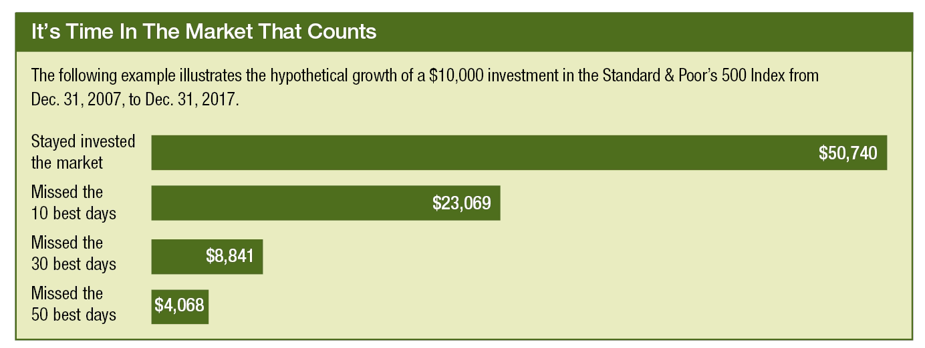
When is a good time to be in the market?
Source: Standard & Poor’s historical data and The Standard’s internal calculation, 2013. This illustration is hypothetical and for illustrative purposes only and is not indicative of the performance of any specific investment. Past performance is no guarantee of future results. Investments are subject to market risk and fluctuate in value. The S&P 500 is an index of 500 widely traded stocks and is considered to represent the performance of the stock market in general. An investment cannot be made directly in an index.
Basics of the Financial Markets

Slide 18
Keep learning
Online
www.morningstar.com
www.nyse.com
www.nasdaq.com
www.dowjones.com
Periodicals
Money magazine
Forbes magazine
The Wall Street Journal
The “Money” section of USA Today or similar sections of your
local paper
Basics of the Financial Markets

Slide 19
Thank you!

Slide 20
Employers and plan participants
Employers and plan participants should carefully consider the investment objectives, risks, charges and expenses of the investment options offered under the retirement plan before investing. The prospectuses for the individual mutual funds and each available investment option in the group annuity contain this and other important information. Prospectuses may be obtained by calling 877.805.1127. Please read the prospectus carefully before investing. Investments are subject to market risk and fluctuate in value.
The Standard is the marketing name for StanCorp Financial Group, Inc., and its subsidiaries. StanCorp Equities, Inc., member FINRA, wholesales a group annuity contract issued by Standard Insurance Company and a mutual fund trust platform for retirement plans. Standard Retirement Services, Inc., provides financial recordkeeping and plan administrative services. Investment advisory services are provided by StanCorp Investment Advisers, Inc., a registered investment advisor. StanCorp Equities, Inc., Standard Insurance Company, Standard Retirement Services, Inc., and StanCorp Investment Advisers, Inc., are subsidiaries of StanCorp Financial Group, Inc., and all are Oregon corporations.
RP 11404-PPT (3/18)

