Slide 1



Got Student Loan Debt?
Don’t forget to save for retirement
Retirement on the Brain
Notes:
Your employer offers a retirement plan to help you save for the future.
Investing in a retirement plan will help you worry less about paying the bills and enjoying life when you’re no longer earning a regular paycheck.
If you have a student loan to pay off, saving for retirement may seem like a low priority. But there are definitely downsides to putting off this important financial goal.
What’s your best move when it comes to paying down a loan or saving for the future?
That’s what we’ll explore today.

Slide 2



Speakers
First Last Name
Title, The Standard
First Last Name
Title, The Standard
Retirement on the Brain
Notes:
[INTRODUCTIONS]

Slide 3






Totaling Up Student Debt
Percentage of recent grads with student debt: 45%
Source: NerdWallet/Harris Poll, May 2018
Average student debt for 2018 graduates:
$30,000
Source: savingforcollege.com
Notes:
If you have a student loan to pay off, you’re not alone.
According to NerdWallet, 45 percent of recent graduates are carrying student debt.
And according to the website savingforcollege.com, a 2018 college graduate averages $30,000 in student debt.
[OPTIONAL STATS]
Government statistics show that 44.5 million people have federal student loans in 2018. That equals $1.5 trillion in outstanding federal student loan debt.
As the size of student debt owed has increased, so have monthly payments. The Federal Reserve estimated that the average monthly student loan payment increased from $227 in 2005 to $393 in 2016.
Percentage of Americans with student loan debt who are under 30: 37.5%
Percentage of Americans with student loan debt who are 30 or older: 62.5%
Source: Federal Reserve Bank of New York, 2018

Slide 4

But if you're putting little or nothing in your retirement plan ...
4
Notes:
It may seem impossible to pay off your student loan and also save for the future.
The problem is that the longer you wait to start putting money into your retirement plan, the harder it is to save enough to live on when you stop working.

Slide 5
Should You Pay Down
Your Loan or Save Up for Retirement?
Let’s explore 2 options.
Notes:
So should you pay down or save up?
In most cases, saving for retirement – even a small amount – should be part of your game plan.
Let’s explore 2 options.

Slide 6

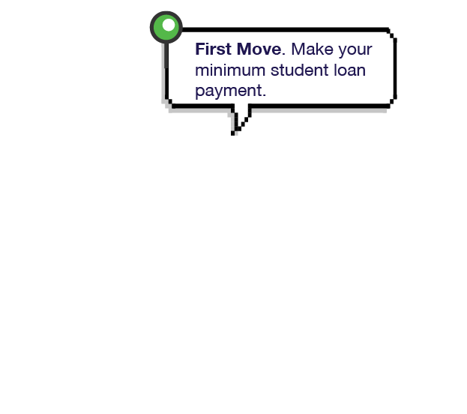


Game 1: Pay Down (1 of 5)
Notes:
The first option focuses on just paying down your student loan.
Make the minimum monthly payment on your student loan.

Slide 7
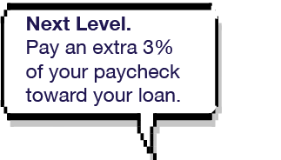
Game 1: Pay Down (2 of 5)
Game 1: Pay Down
Notes:
Then check your finances to see if you can pay a bit more.
Are you expecting a tax refund, bonus or raise?
Think about putting that extra money toward paying off your loan.
Just remember that when you’re putting all of your funds toward paying down your loan, you’re not saving as much for retirement.

Slide 8

Game 1: Pay Down (3 of 5)
Notes:
You’ll pay off your student loan a little early. Then you can start saving more for retirement.

Slide 9

Game 1: Pay Down (4 of 5)
Game 1: Pay Down
Game 1: Pay Down
Notes:
You’ll pay off your student loan a little early. Then you can start saving more for retirement.

Slide 10

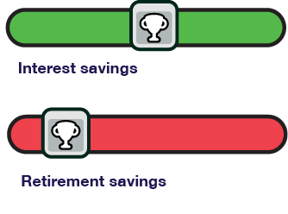
Game 1: Pay Down (5 of 5)
Paying off your student loan debt sooner means you can avoid paying all that interest. But paying more toward your loan doesn’t help you build savings.
Notes:
By focusing on paying off your loan, you’ll avoid paying all that interest.
But remember that while you’ve been focused on paying down your debt, you haven’t saved or invested as much money for retirement. You may have to play catchup to save enough for the future.

Slide 11
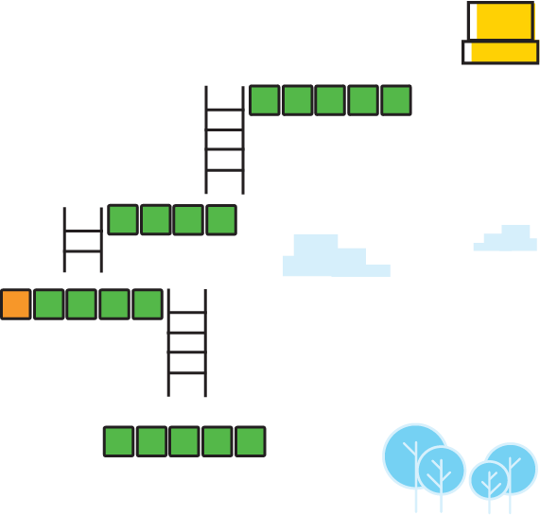
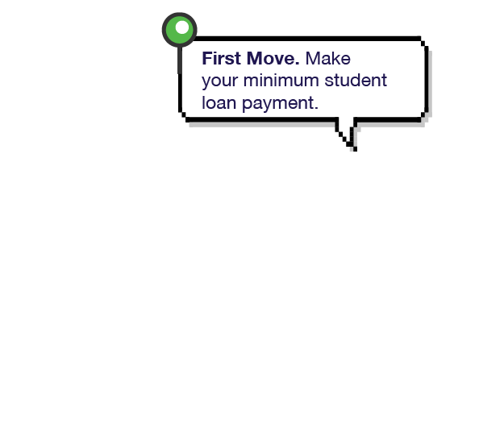


Game 2: Pay Down and Save Up (1 of 6)
Notes:
Let’s look at an option where you pay down your loan AND save for the future.
Make the minimum payment possible on your student loan each month.

Slide 12
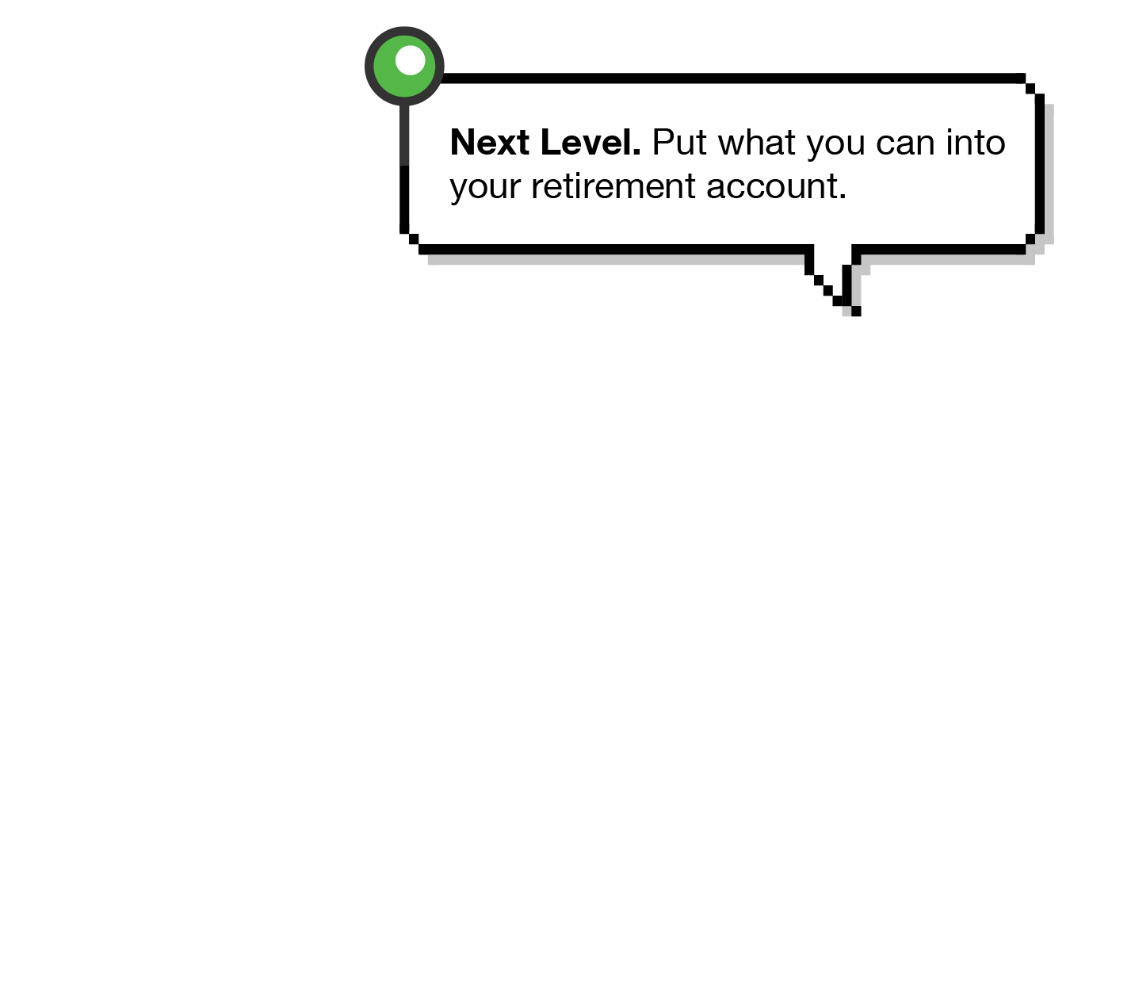
Game 2: Pay Down and Save Up (2 of 6)
Notes:
Check your finances to see if you can put extra funds toward retirement.
Enroll in your retirement account and start contributing on a regular basis. Or increase your regular contribution if you’re already enrolled.
If your employer offers a match, contribute enough to meet the match. For example, if your employer matches up to 3% of your paycheck, put at least that much into your account.
Employer matching helps you earn even more on your investment.

Slide 13
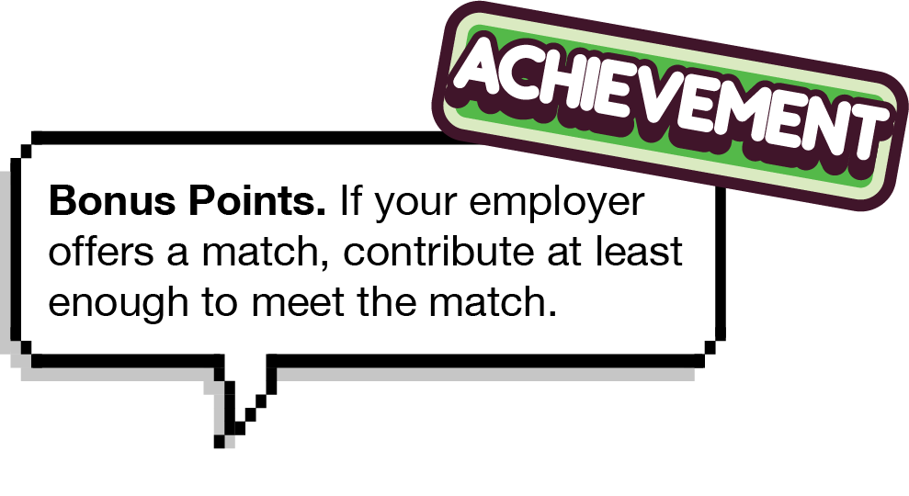
Game 2: Pay Down and Save Up (3 of 6)
Notes:
Check your finances to see if you can put extra funds toward retirement.
Enroll in your retirement account and start contributing on a regular basis. Or increase your regular contribution if you’re already enrolled.
If your employer offers a match, contribute enough to meet the match. For example, if your employer matches up to 3% of your paycheck, put at least that much into your account.
Employer matching helps you earn even more on your investment.

Slide 14
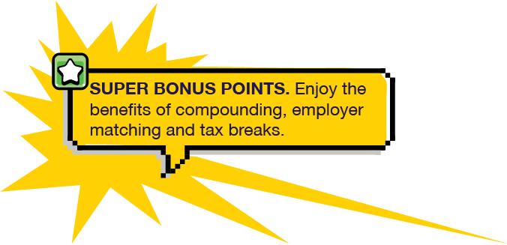
Game 2: Pay Down and Save Up (4 of 6)
Notes:
When you’re focusing on both goals -- paying down your loan and saving for retirement – there are plenty of positives. These include compounding, employer matching and tax breaks.

Slide 15
Game 2: Pay Down and Save Up (5 of 6)
Compounding: This happens when the earnings on your savings are reinvested and start earning a return on their own. Saving early means more years of compounding.
Employer matching: An employer match is like free money. If you don’t contribute enough to get the match, you’re missing out.
Tax breaks: As you balance paying off debt and saving for retirement, remember that retirement plan contributions may offer more of a
tax advantage.
15
Notes:
Compounding happens when the interest on your investments is reinvested and starts earning a return, too. Saving early gives you more years of compounding.
We’ve already talked about taking advantage of employer matching. Think of a match as free money. If you don’t save enough to get the match, you’re missing out on free money.
And don’t forget the tax breaks you may get from a retirement plan. Typically, your contributions are made with pre-tax dollars, and you don’t pay taxes until you withdraw money.

Slide 16

Game 2: Pay Down and Save Up (6 of 6)
When you pay off your student loan, you’ll have a nice stash of money in your retirement account because you’ve been saving all along.
16
Notes:
When your student loan is paid off, redirect your loan payment to your retirement plan.
By paying down and saving up, your retirement savings will have time to add up. You’ll have less to worry about when you stop getting a regular paycheck.

Slide 17





Why Join Your Plan?
Automatic
Savings
Tax
Advantages
Investment
Options
Compounding
Employer
Match
Notes:
[1 Click for each animation]
If you haven't enrolled in your employer's plan, here are five of the best reasons to sign up today:
It’s easy – saving is automatic. Contributions to your retirement plan are taken directly out of your paycheck. This makes saving easy and seamless. And you can take your savings with you if you leave your job.
There are tax advantages. Your contributions are made before taxes are withheld. This reduces your taxable income and income taxes.
Your plan's investment options have been put through a comprehensive review process. This helps ensure that you have a diverse and appropriate selection of options to choose from.
Compounding happens. The earnings on your savings are reinvested and start earning an investment return of their own. The earlier you start saving, the more likely you'll benefit from compounding.
“Free money.” Your employer may match part of your contribution. That means you may be able to double your contributions up to a limit.

Slide 18




Why Join Your Plan?
Age 20-35
Target Savings Goal:
10-15% each paycheck
Aim to Save:
1x annual salary
Age 36-50
Target Savings Goal:
15-20% each paycheck
Aim to Save:
3.5x annual salary
Age 51+
Target Savings Goal:
20% each paycheck
Aim to Save:
7x annual salary
Notes:
Check out these guidelines to saving for retirement at each life stage.
For example, the ideal target savings goal for a 45-year-old is 15 to 20 percent of your paycheck.
At this age, you’re in good shape if you have 3.5 times your current annual salary already saved in a retirement account.

Slide 19




Want help figuring out your best move?
Use our calculator
to crunch the numbers.
Go to standard.com/paydown-or-saveup.
Notes:
We’ve created a calculator to help you plan. It can help you identify options for paying down student debt and saving for retirement.
Just answer a few questions about your finances, such as your loan amount and interest rate, and your salary. We’ll help you do the math. The results can help you decide whether to pay down your loan first or pay down and save up for retirement at the same time.
You can find the calculator at XXXXXX.

Slide 20

Questions?
When you’re ready to head to the next level, enroll in your retirement plan or increase your contribution. Go to standard.com/retirement.
Notes:
When you’re ready, here’s where to go to enroll in your retirement plan or increase your current contribution:
standard.com/retirement
Thank you for being here today. I’m here to answer questions.

Slide 21
Disclosures
The Standard is the marketing name for StanCorp Financial Group, Inc., and its subsidiaries. StanCorp Equities, Inc., member FINRA, wholesales a group annuity contract issued by Standard Insurance Company and a mutual fund trust platform for retirement plans. Standard Retirement Services, Inc. provides financial recordkeeping and plan administrative services. Investment advisory services are provided by StanCorp Investment Advisers, Inc., a registered investment advisor. StanCorp Equities, Inc., Standard Insurance Company, Standard Retirement Services, Inc., and StanCorp Investment Advisers, Inc., are subsidiaries of StanCorp Financial Group, Inc., and all are Oregon corporations.
RP 20155 (6/19)

